Slide 1
How do we become partakers of Christ’s redemption?
He saved us, not on the basis of deeds which we have done in righteousness, but according to His mercy, by the washing of regeneration and renewing by the Holy Spirit, whom He poured out upon us richly through Jesus Christ our Savior (NASB; Tit. 3:5-6).
No one can say, “Jesus is Lord,” except by the Holy Spirit
(NASB; I Cor. 12:3).
45

Slide 2
We become partakers of Christ’s redemption by the effectual application of it to us by His Holy Spirit.
(Westminster Shorter Catechism, Q. 29)
(Note: What neither the light of nature, nor the law could do, that God performs by the operation of the Holy Spirit through the Word or ministry of reconciliation, which is the glad tidings concerning the Messiah, by means whereof it hath pleased God to save such as believe, as well under the Old, as under the New Testament (Canons of Dort, Chapters 3 and 4, Article 6).)

Slide 4
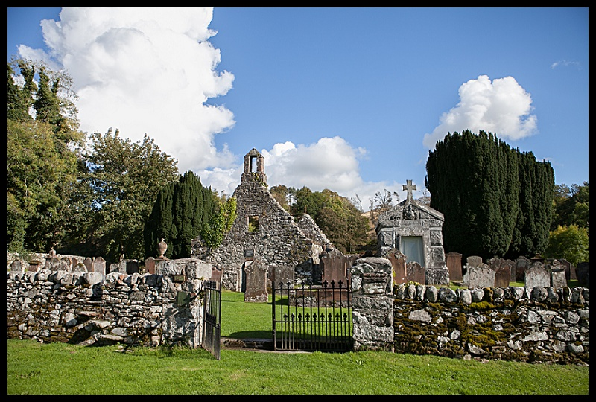

Slide 5
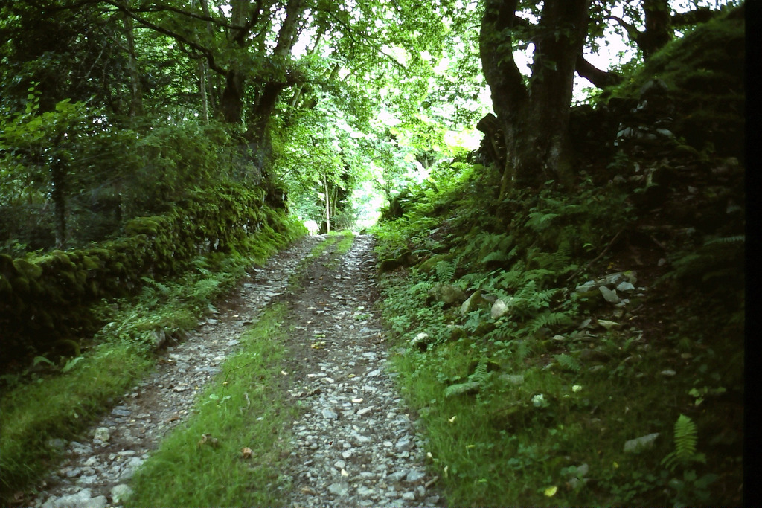

Slide 6
Today went up to the wood above us, and, after looking from the top, sat down and had two
hours’ meeting with the Lord in prayer
and praise.
The Lord came near, that same Lord
who used to fill the heart of Rutherford.
I see that faith is high just when our
thoughts about the Lord Himself are
high and great and satisfying.
--Andrew Bonar (Aug. 20th, 1878)

Slide 7
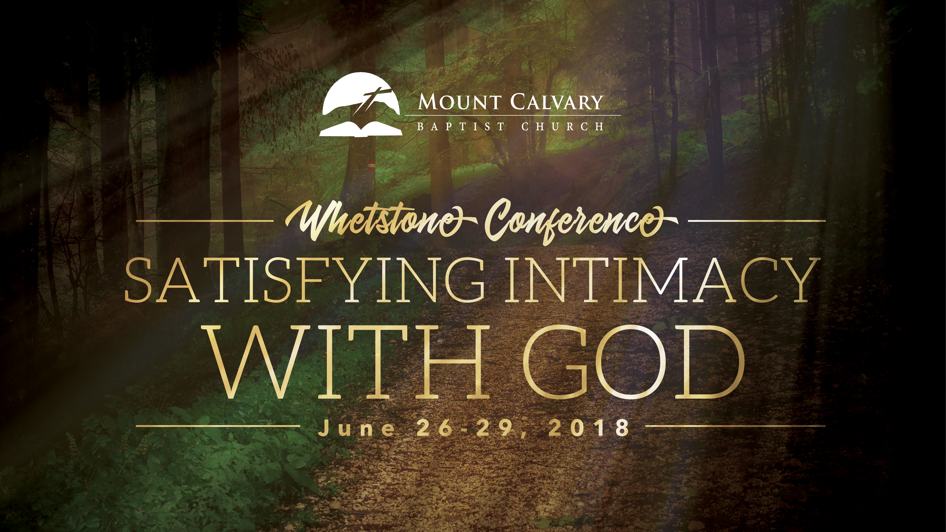

Slide 9
Soul Thirst in Pulpit and Pew
Tuesday night 7:15

Slide 10
Congregational Psalm Singing
Dr. Peter Davis
Wednesday, 7:15

Slide 11
???
Dr. Ken Casillas
Thursday, 7:15

Slide 12
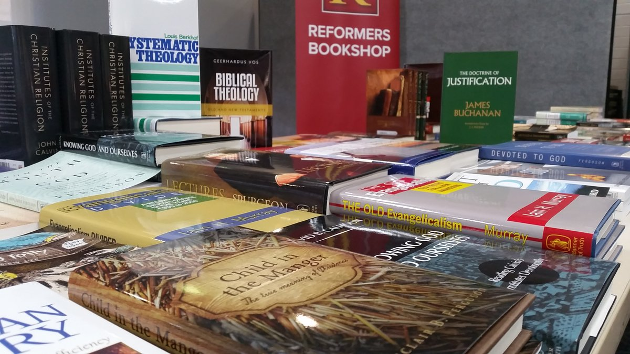

Slide 13
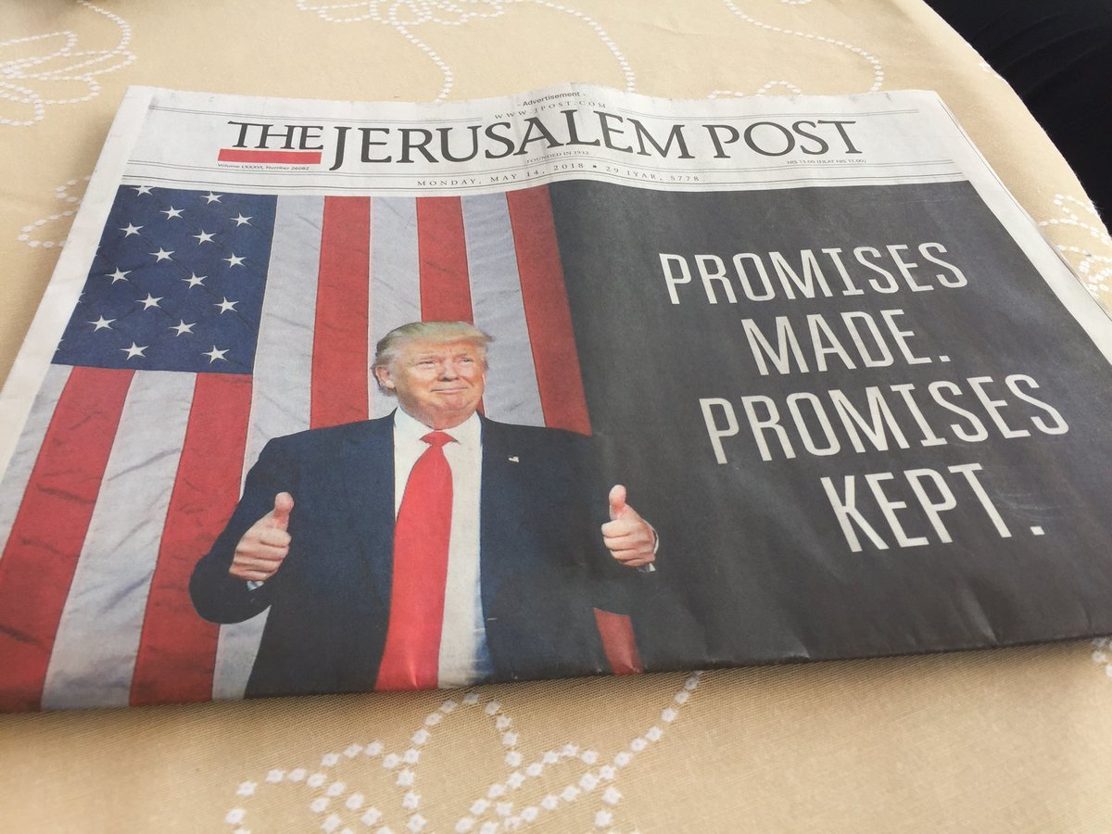

Slide 14
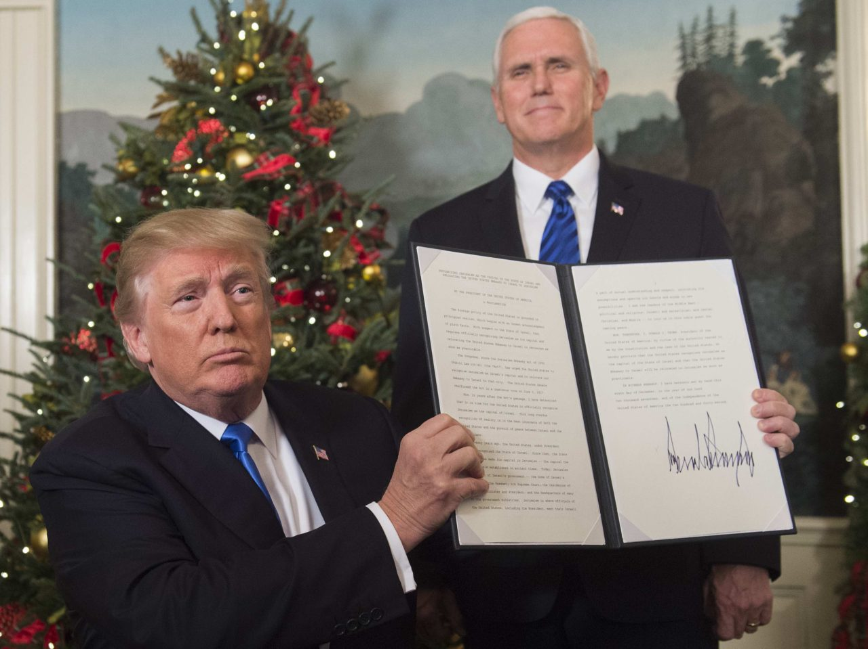
US President Donald Trump holds up a signed memorandum recognizing Jerusalem as Israel's capital, as US Vice President looks on, at the White House, on December 6, 2017.

Slide 15
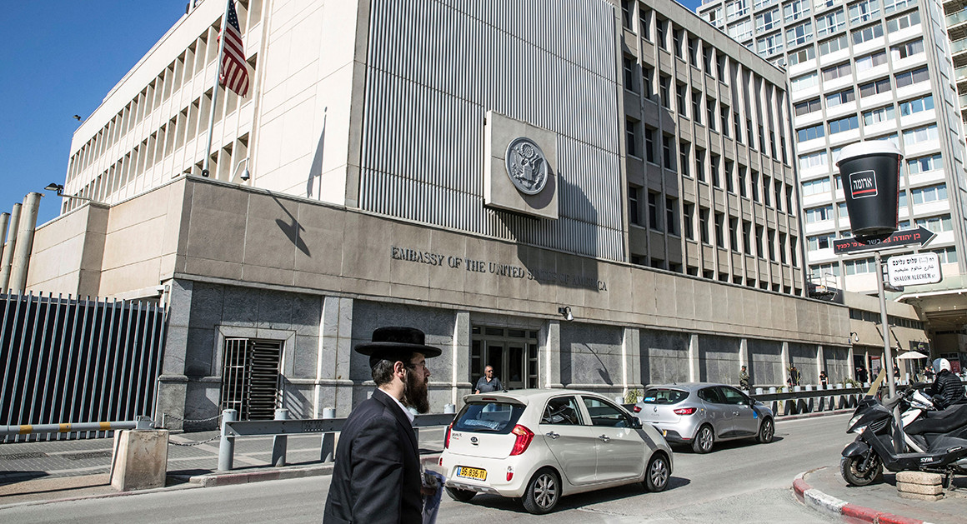

Slide 16
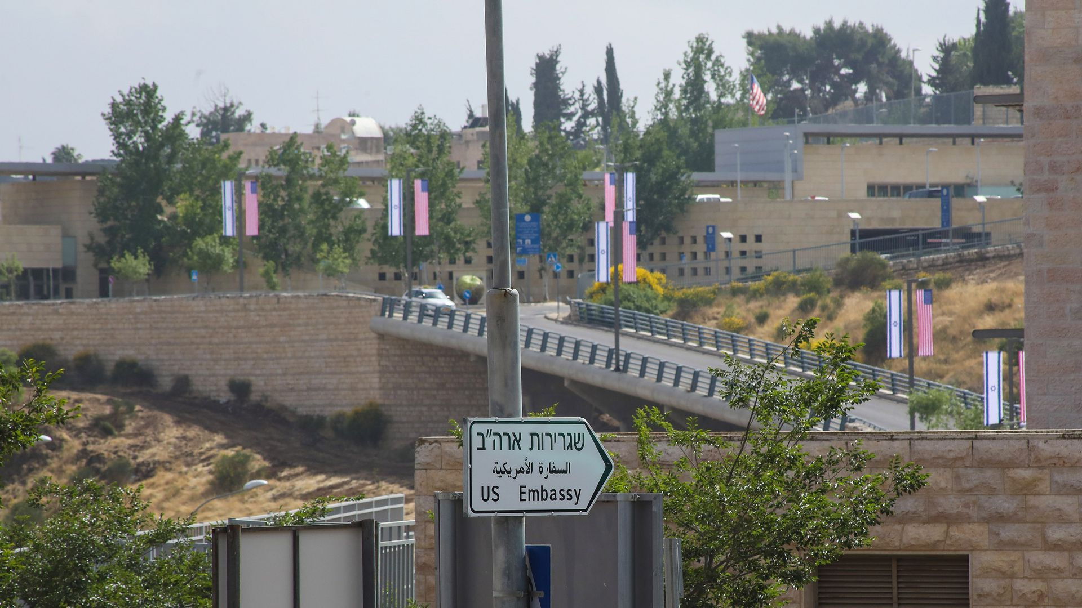

Slide 17
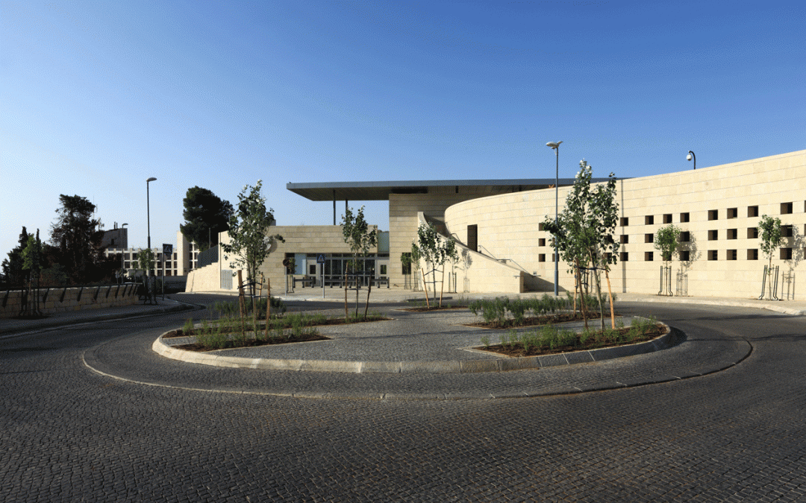

Slide 18
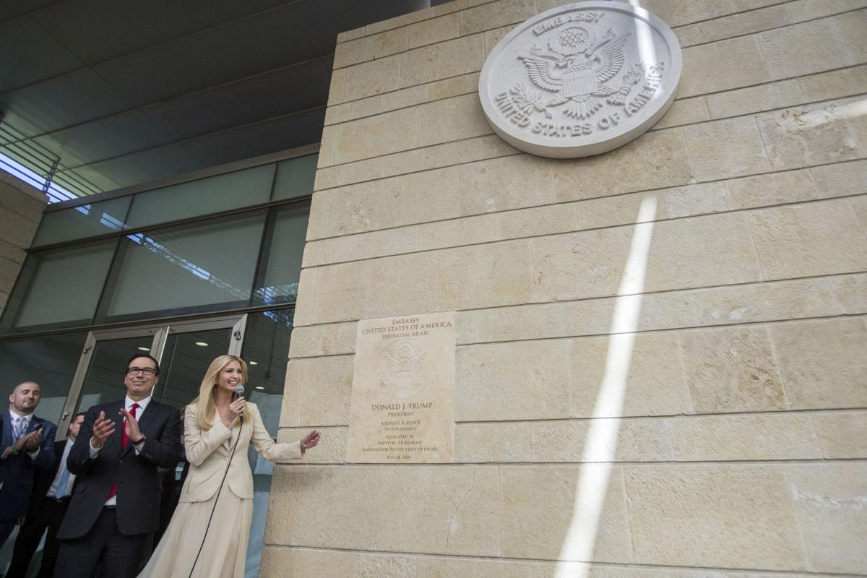

Slide 19
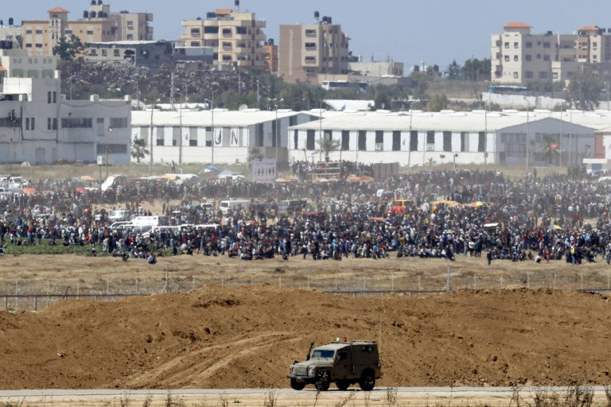

Slide 20
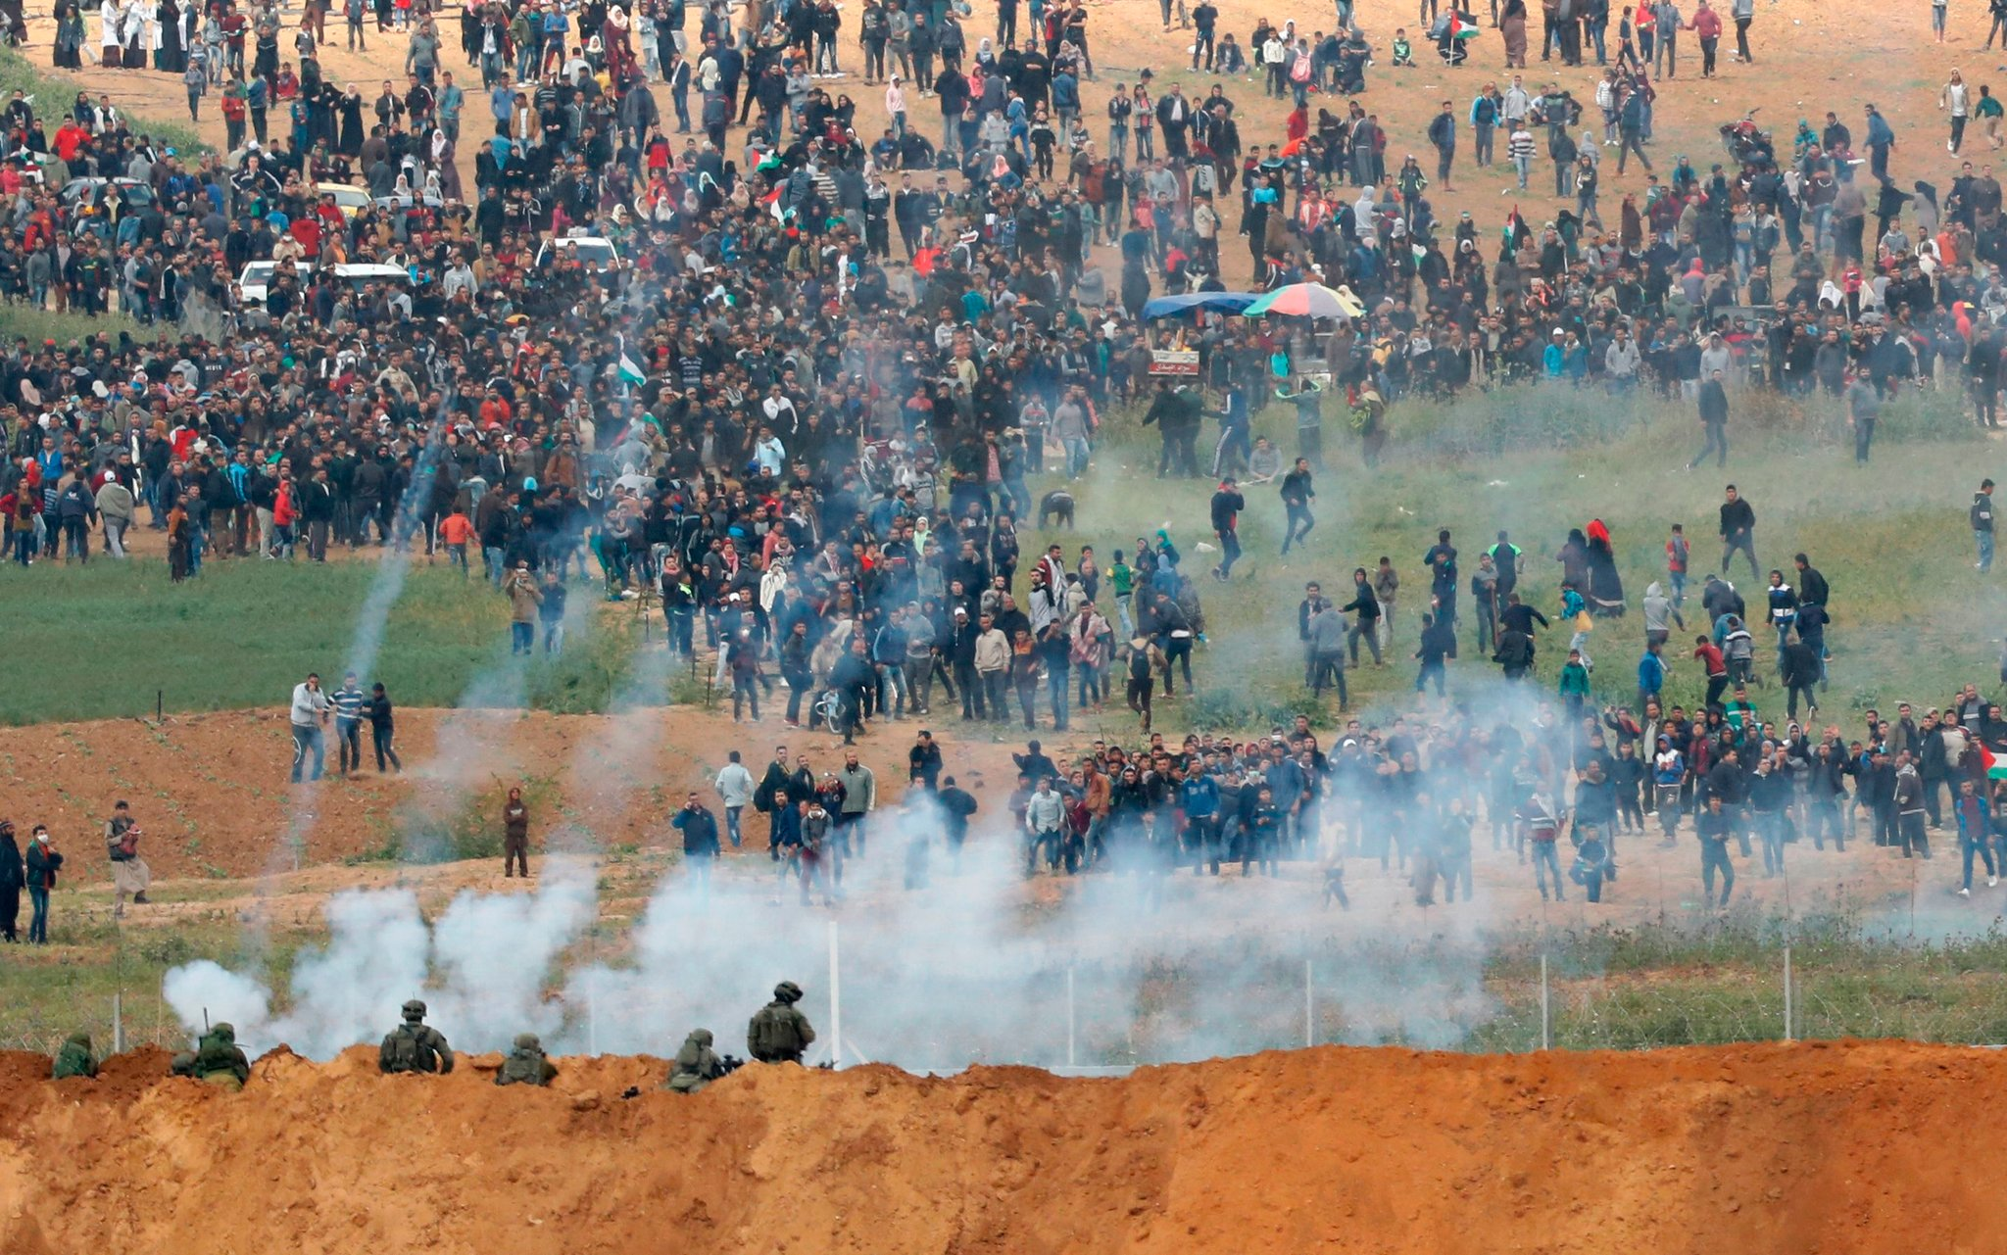

Slide 21
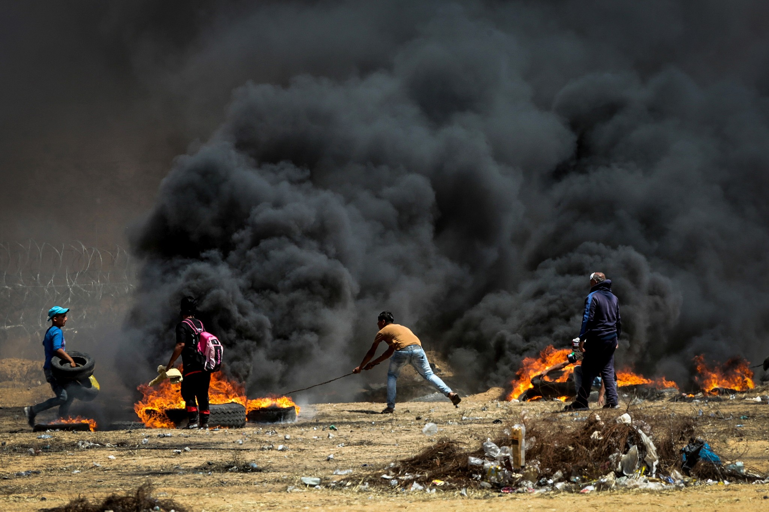

Slide 22
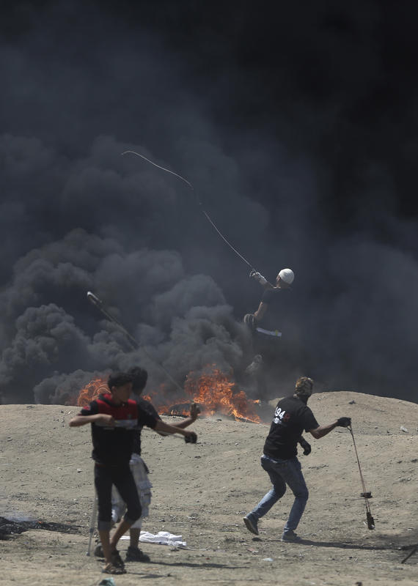

Slide 23
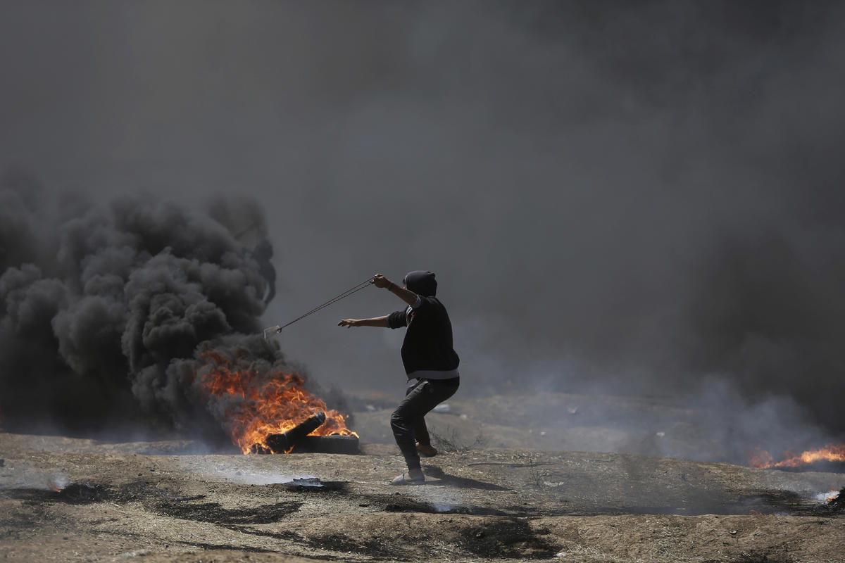

Slide 24
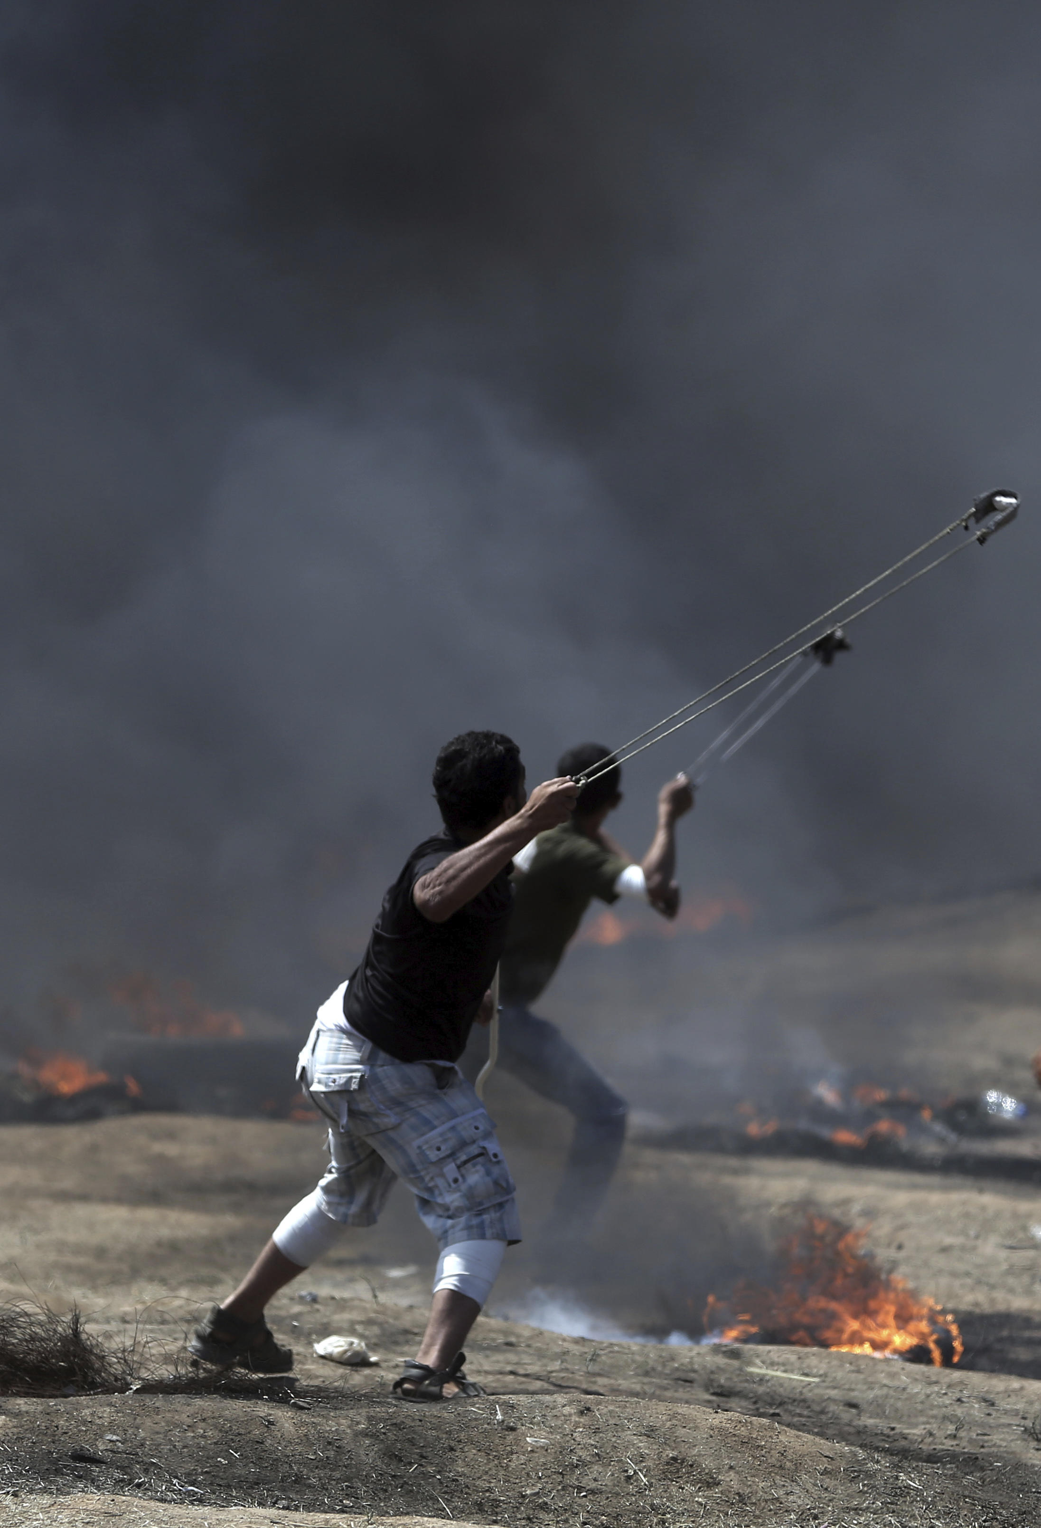

Slide 25
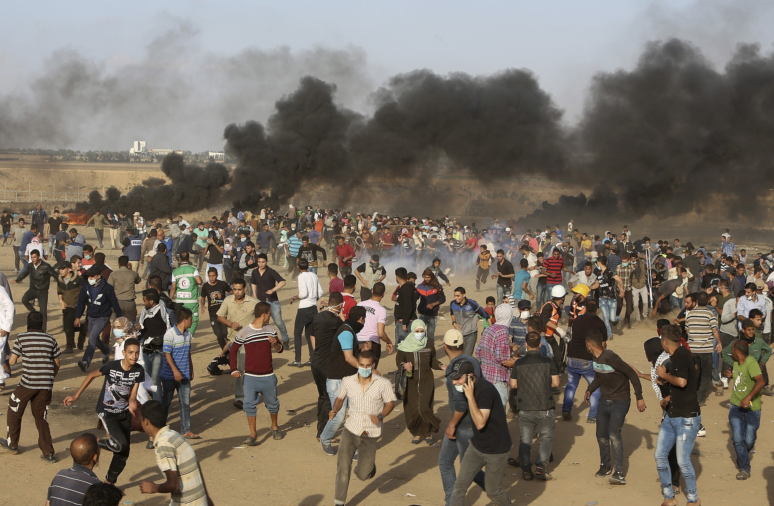

Slide 26
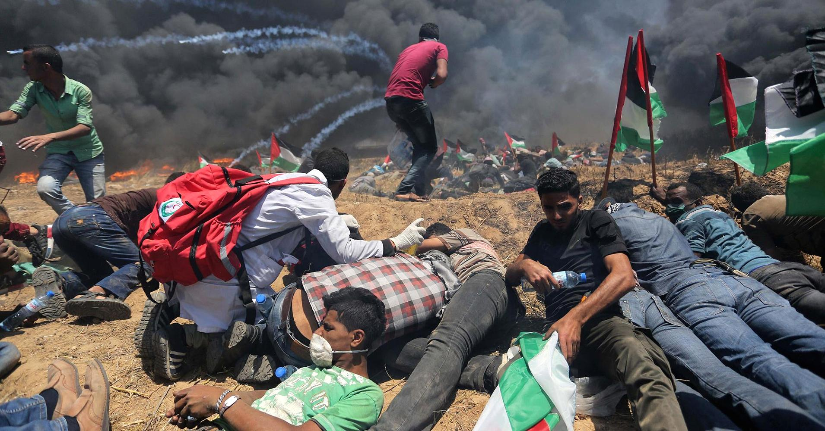

Slide 27
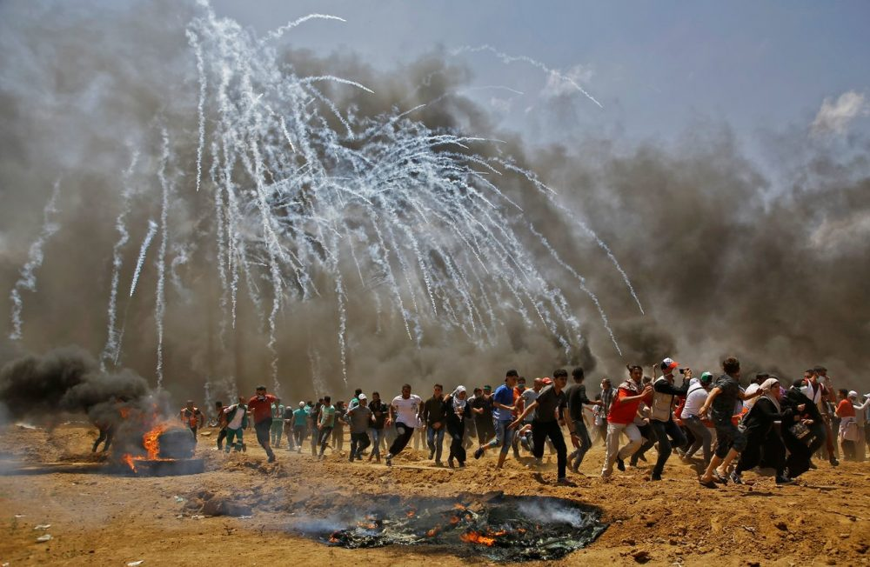

Slide 28
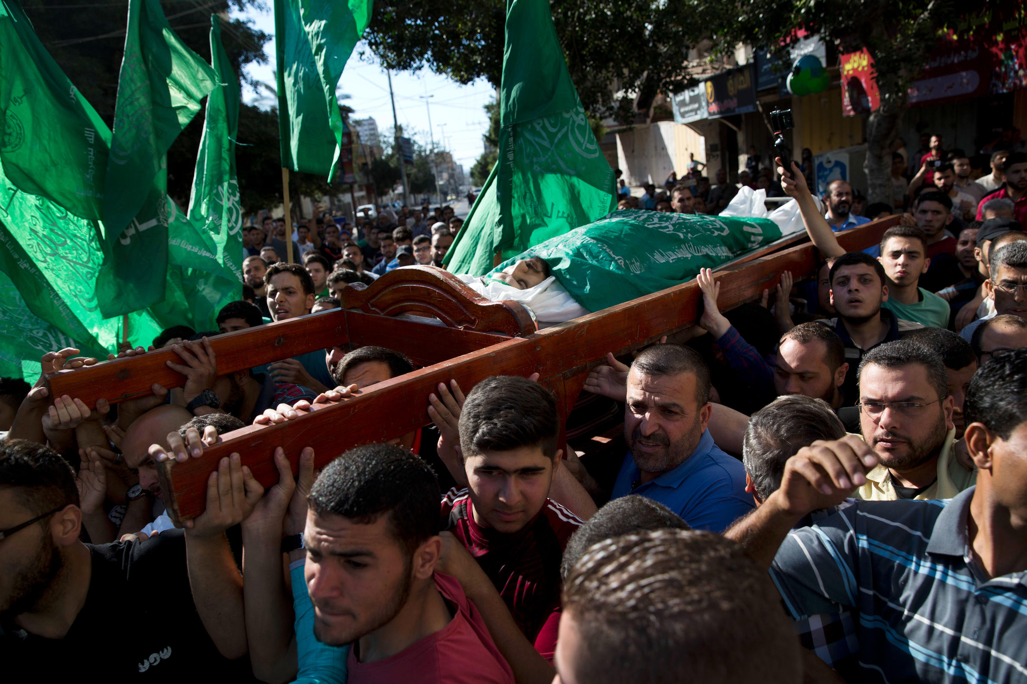

Slide 29
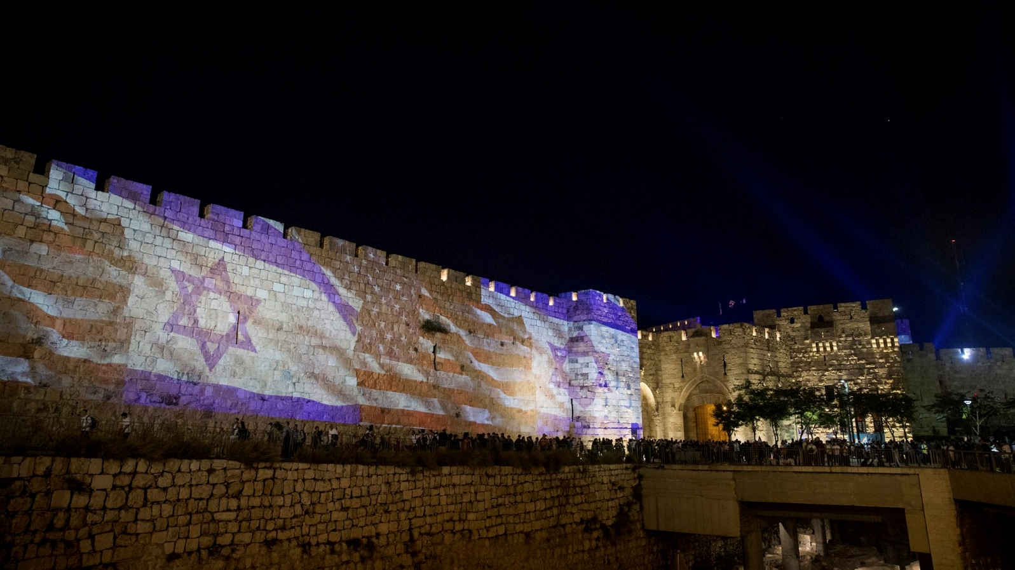

Slide 30
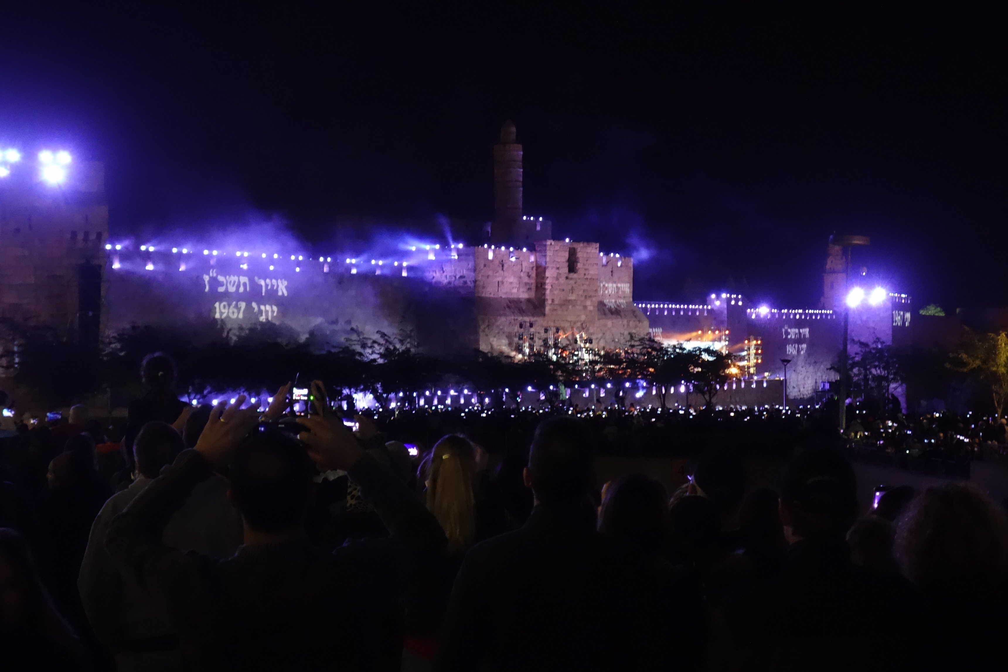

Slide 31
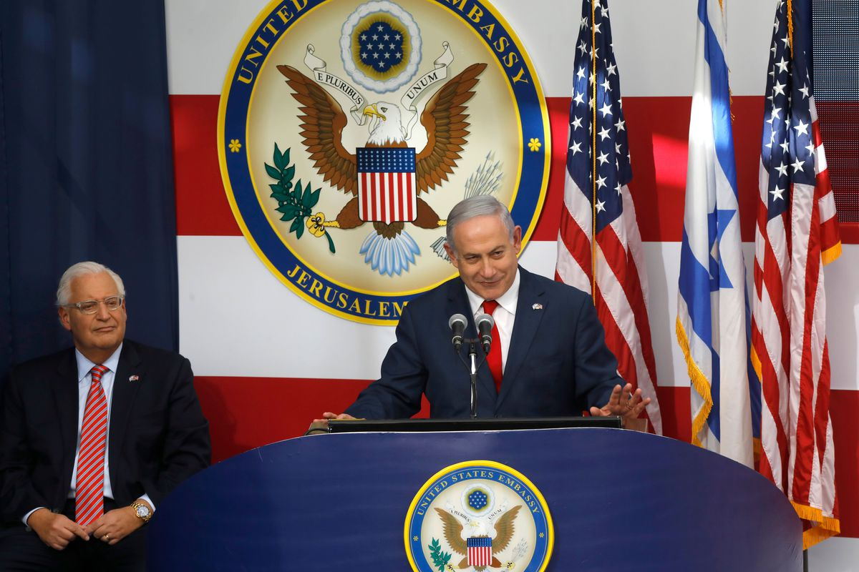

Slide 32
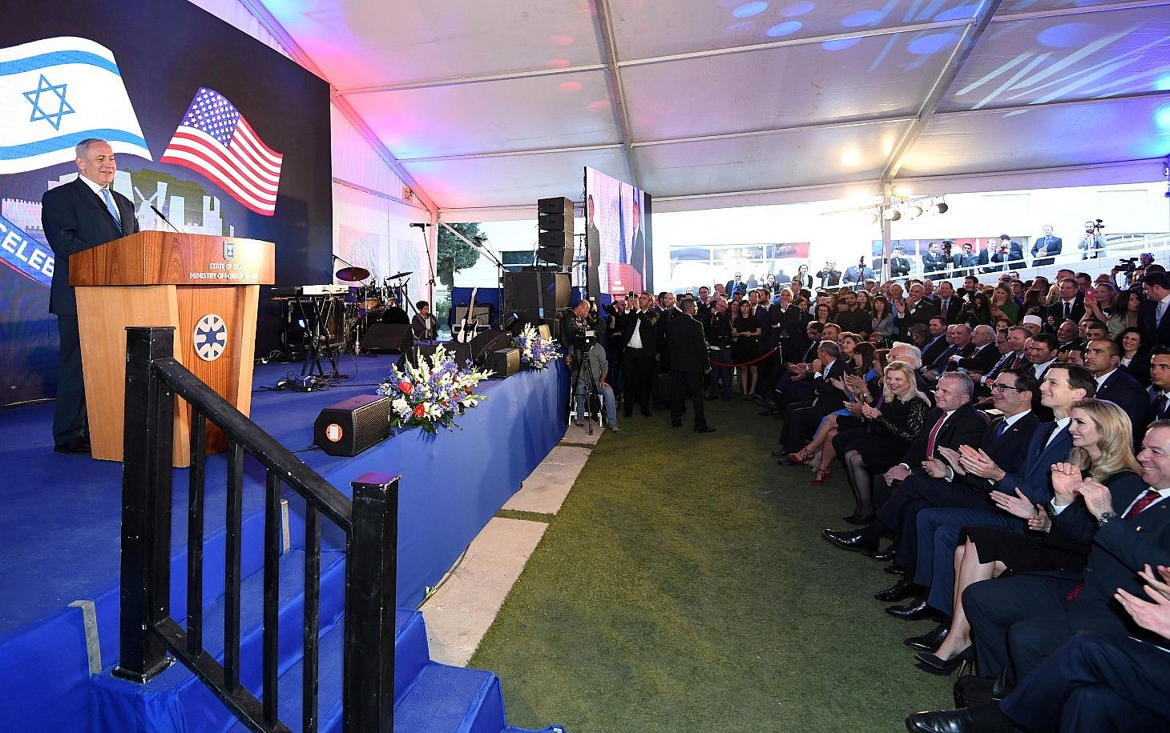

Slide 33
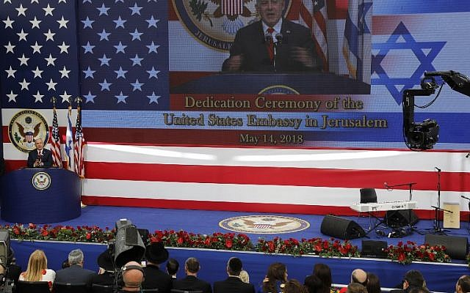

Slide 34
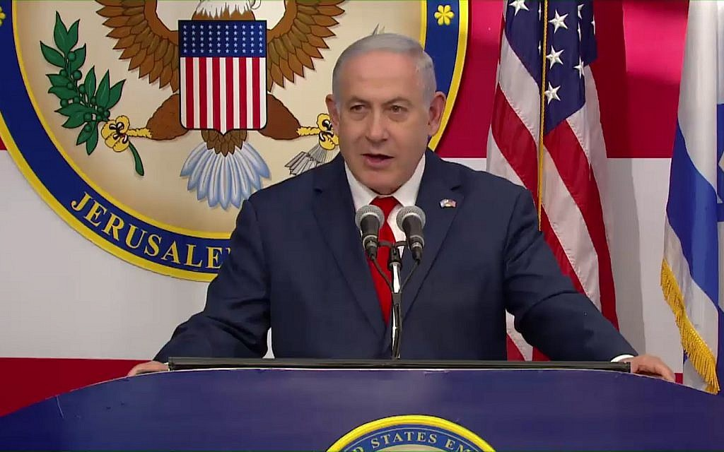
. . . for me this spot brings back personal memories, but for our people, it evokes profound collective memories of the greatest moments we have known on this City on a Hill.
In Jerusalem, Abraham passed the greatest test of faith and the right to be the father of our nation.

Slide 35
In Jerusalem, King David established our capital three thousand years ago.
In Jerusalem, King Solomon built our Temple, which stood for many centuries.

Slide 36
In Jerusalem, Jewish exiles from Babylon rebuilt the Temple, which stood for many more centuries.
In Jerusalem, the Maccabees rededicated that Temple and restored Jewish sovereignty in this land.

Slide 37
And it was here in Jerusalem some two thousand years later that the soldiers of Israel spoke three immortal words, ‘Har ha’bayit be’yadeinu,’ ‘The Temple Mount is in our hands,’ words that lifted the spirit of the entire nation.
We are in Jerusalem and we are here to stay.
. . . exactly 70 years ago today, President Truman became the first world leader to recognize the newborn Jewish state. Last December, President Trump became the first world leader to recognize Jerusalem as our capital. And today, the United States of America is opening its embassy right here in Jerusalem.
Thank you. Thank you, President Trump, for having the courage to keep your promises. Thank you, President Trump, and thank you all, for making the alliance between America and Israel stronger than ever. And thank you, a special thank you, to you, Ambassador Friedman. Thank you, David, for everything you do to bring our countries and our peoples closer together. Today, you have a special privilege. You are privileged to become the first American ambassador to serve your country in Jerusalem, and this is a distinct honor that will be yours forever. Nobody can be first again.
My friends, this is a great day for Israel. It’s a great day for America. It’s a great day for our fantastic partnership. But I believe it’s also a great day for peace.
I want to thank Jared, Jason and David for your tireless efforts to advance peace, and for your tireless efforts to advance the truth. The truth and peace are interconnected. A peace that is built on lies will crash on the rocks of Middle Eastern reality. You can only build peace on truth, and the truth is that Jerusalem has been and will always be the capital of the Jewish people, the capital of the Jewish state. Truth, peace and justice – as our Supreme Court Justice here. Hanan Melcer, can attest – truth, peace and justice, this is what we have and this is what we believe in.
The prophet, Zechariah, declared over 2,500 years ago, ‘So said the Lord, ‘I will return to Zion and I will dwell in the midst of Jerusalem. And Jerusalem shall be called the City of Truth.’
May the opening of this embassy in this city spread the truth far and wide, and may the truth advance a lasting peace between Israel and all our neighbors.

Slide 38
Exactly 70 years ago today, President Truman became the first world leader to recognize the newborn Jewish state. Last December, President Trump became the first world leader to recognize Jerusalem as our capital. And today, the United States of America is opening its embassy right here in Jerusalem.
Thank you. Thank you, President Trump, for having the courage to keep your promises. Thank you, President Trump, and thank you all, for making the alliance between America and Israel stronger than ever. And thank you, a special thank you, to you, Ambassador Friedman. Thank you, David, for everything you do to bring our countries and our peoples closer together. Today, you have a special privilege. You are privileged to become the first American ambassador to serve your country in Jerusalem, and this is a distinct honor that will be yours forever. Nobody can be first again.
My friends, this is a great day for Israel. It’s a great day for America. It’s a great day for our fantastic partnership. But I believe it’s also a great day for peace.
I want to thank Jared, Jason and David for your tireless efforts to advance peace, and for your tireless efforts to advance the truth. The truth and peace are interconnected. A peace that is built on lies will crash on the rocks of Middle Eastern reality. You can only build peace on truth, and the truth is that Jerusalem has been and will always be the capital of the Jewish people, the capital of the Jewish state. Truth, peace and justice – as our Supreme Court Justice here. Hanan Melcer, can attest – truth, peace and justice, this is what we have and this is what we believe in.
The prophet, Zechariah, declared over 2,500 years ago, ‘So said the Lord, ‘I will return to Zion and I will dwell in the midst of Jerusalem. And Jerusalem shall be called the City of Truth.’
May the opening of this embassy in this city spread the truth far and wide, and may the truth advance a lasting peace between Israel and all our neighbors.

Slide 39
Thank you. Thank you, President Trump, for having the courage to keep your promises. Thank you, President Trump, and thank you all, for making the alliance between America and Israel stronger than ever.

Slide 40
My friends, this is a great day for Israel. It’s a great day for America. It’s a great day for our fantastic partnership. But I believe it’s also a great day for peace.
The truth and peace are interconnected. A peace that is built on lies will crash on the rocks of Middle Eastern reality.

Slide 41
You can only build peace on truth, and the truth is that Jerusalem has been and will always be the capital of the Jewish people, the capital of the Jewish state. Truth, peace and justice. . . this is what we have and this is what we believe in.

Slide 42
The prophet, Zechariah, declared over 2,500 years ago, ‘So said the Lord, ‘I will return to Zion and I will dwell in the midst of Jerusalem. And Jerusalem shall be called the City of Truth.’ May the opening of this embassy in this city spread the truth far and wide, and may the truth advance a lasting peace between Israel and all our neighbors.

Slide 43
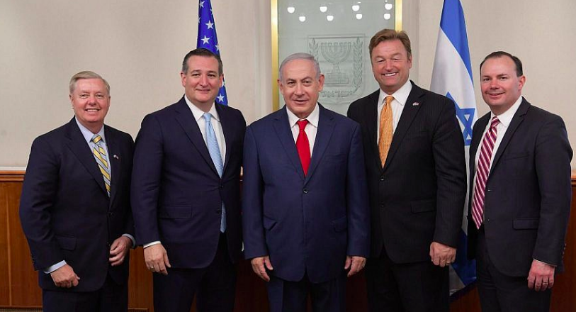

Slide 44
This is a monumental day in United States-Israel relations as we finally open an embassy in Jerusalem, the capital of Israel. “For over 20 years, it has been American policy to recognize Jerusalem as the capital, but it wasn’t until today – and the leadership of President Trump – that we had an embassy in Jerusalem. I truly appreciate the President turning this important recognition into reality.
“At a time of great upheaval across the Middle East, this announcement sends a clear message that the United States has Israel’s back – without equivocation.
“I’m proud to be present and leading the Senate delegation for this historic event. It’s a true honor.”

Slide 45
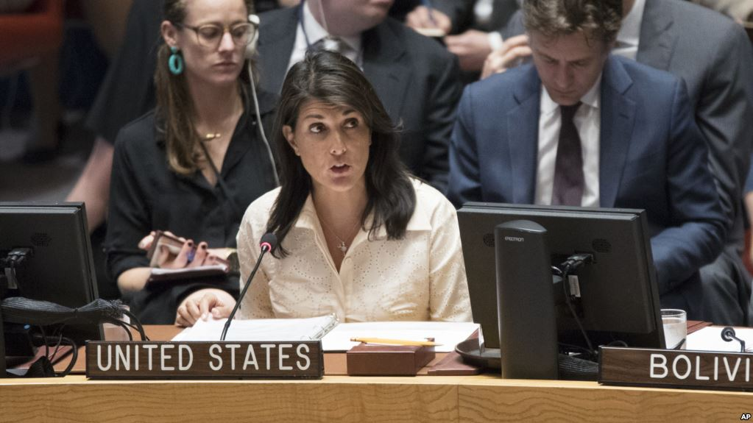

Slide 46
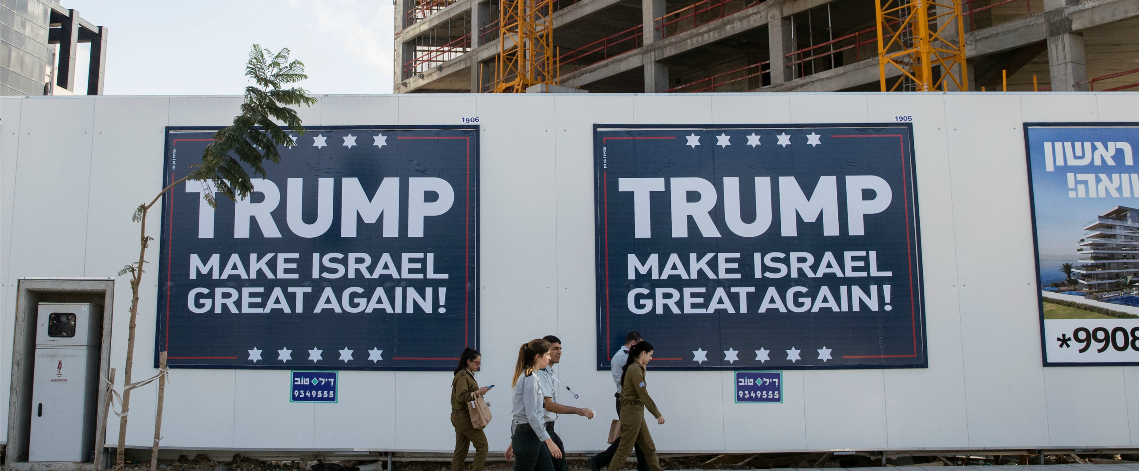

Slide 47
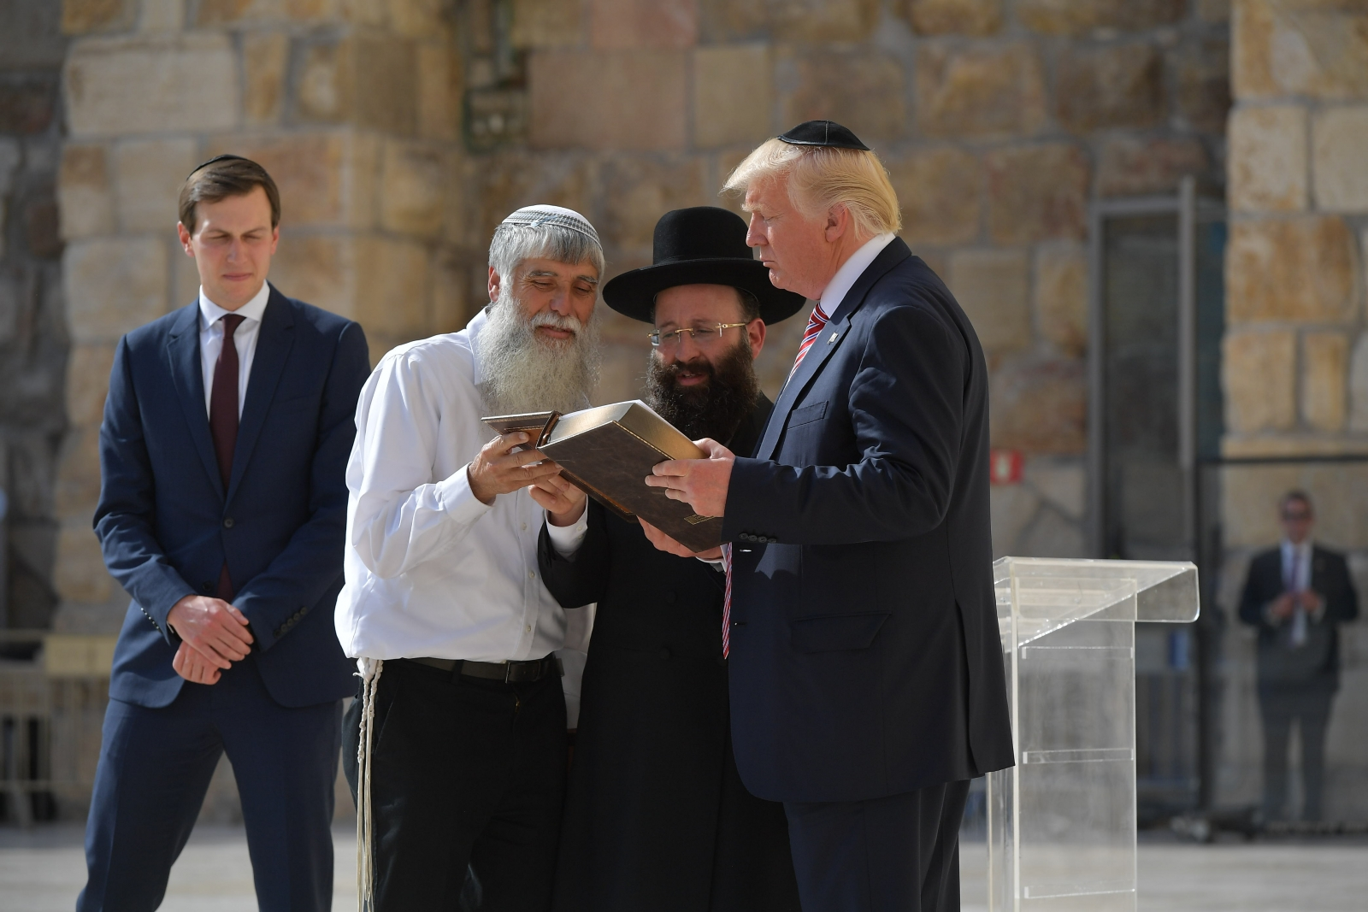

Slide 48
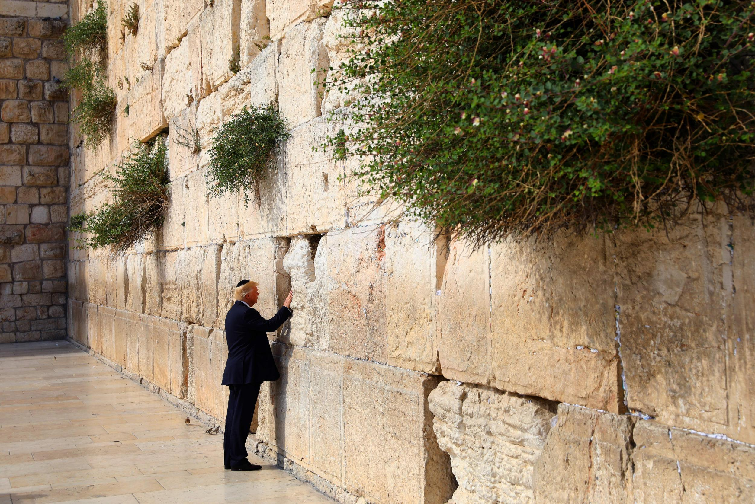

Slide 49
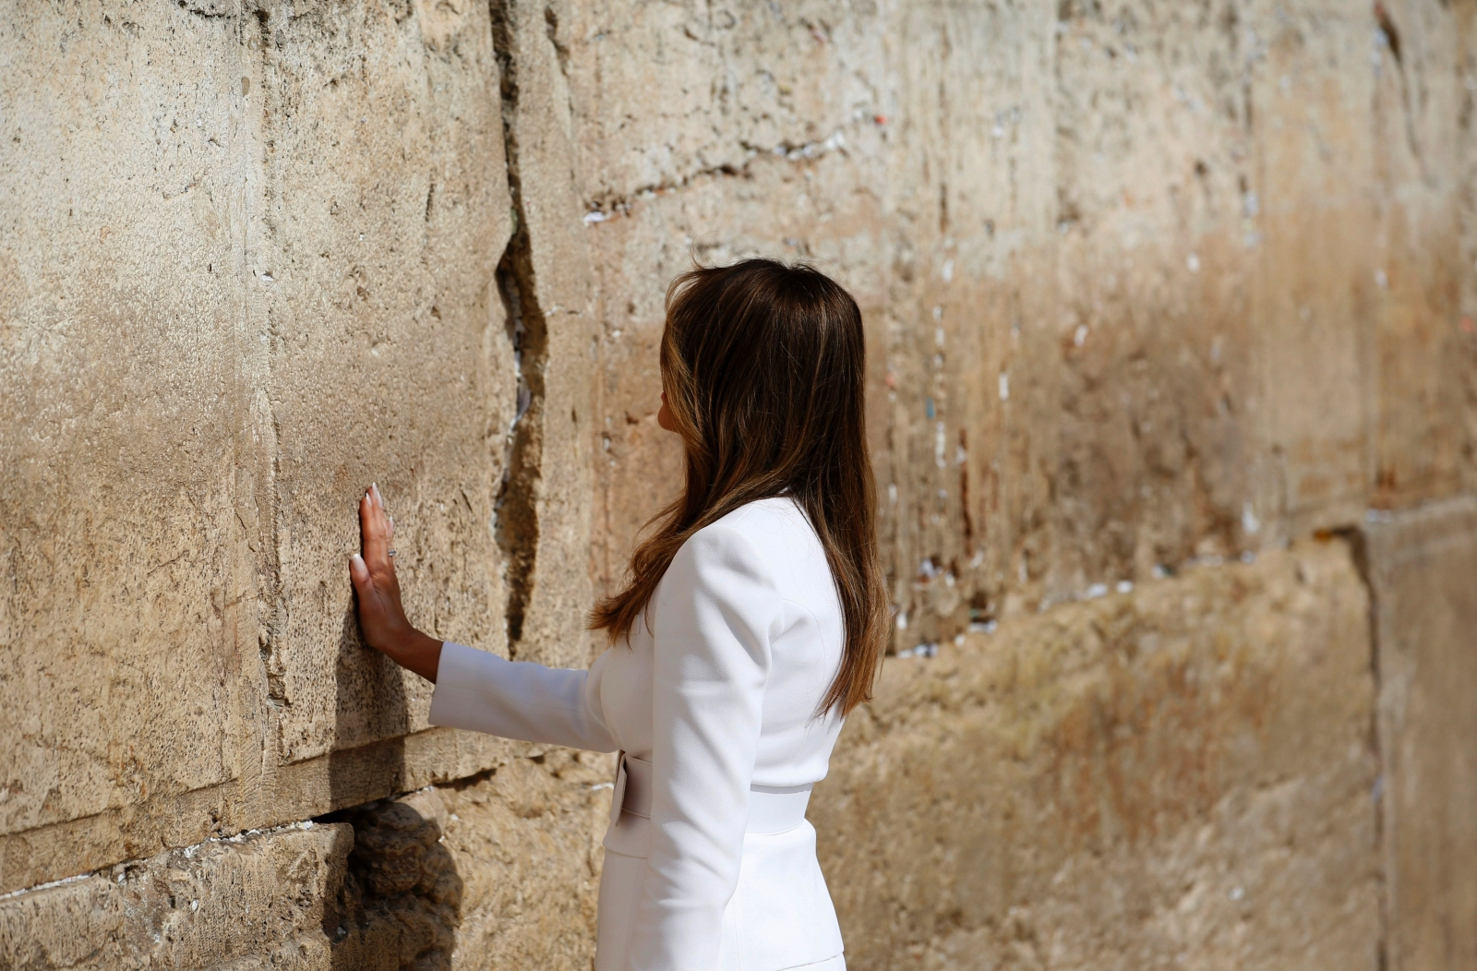

Slide 50
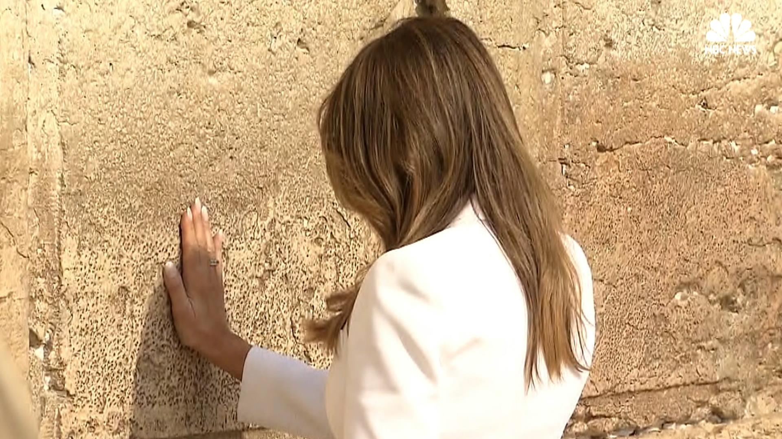

Slide 51
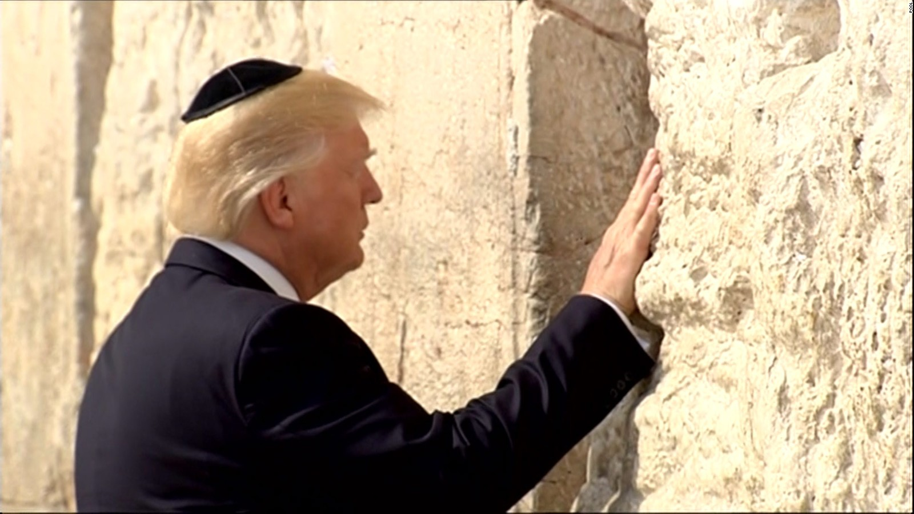

Slide 52
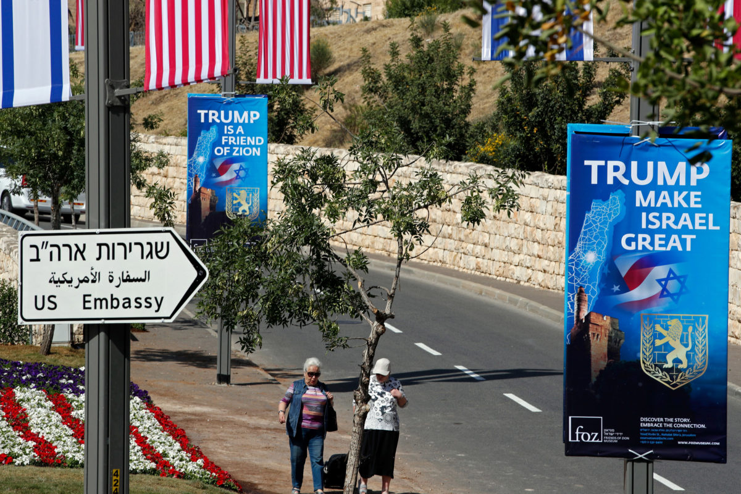

Slide 53
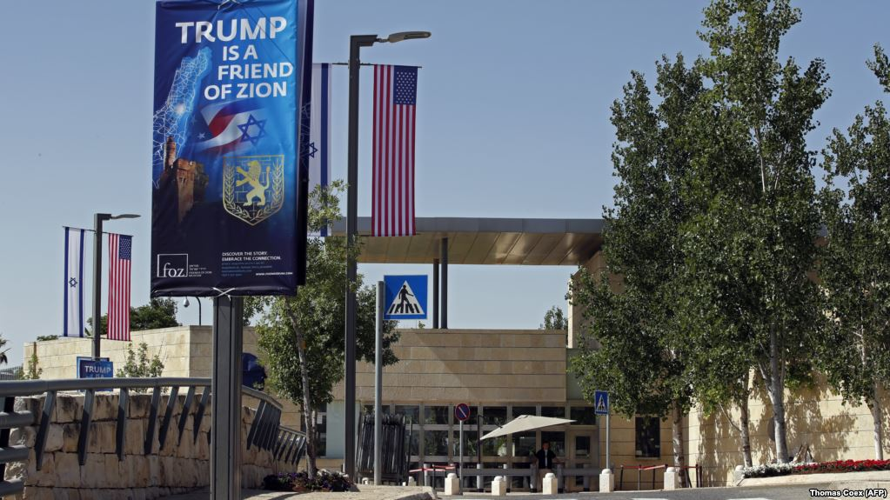

Slide 54
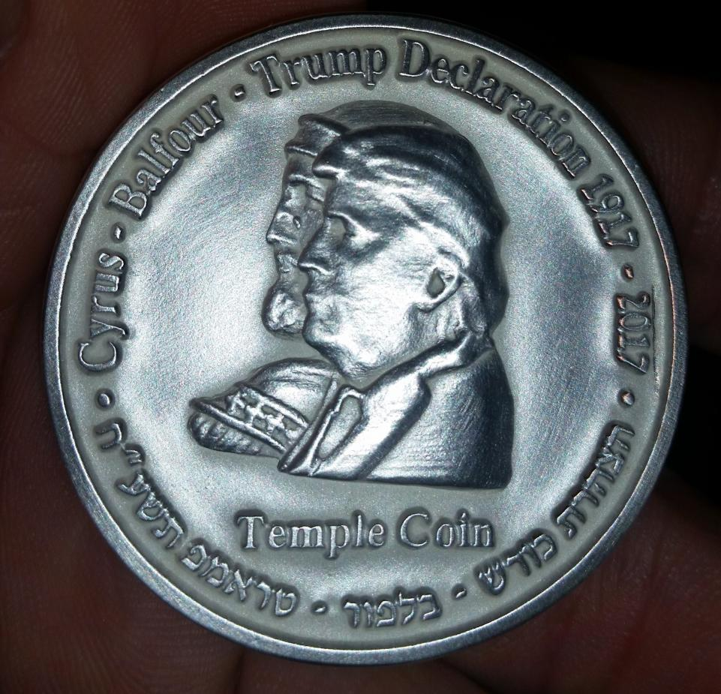

Slide 55
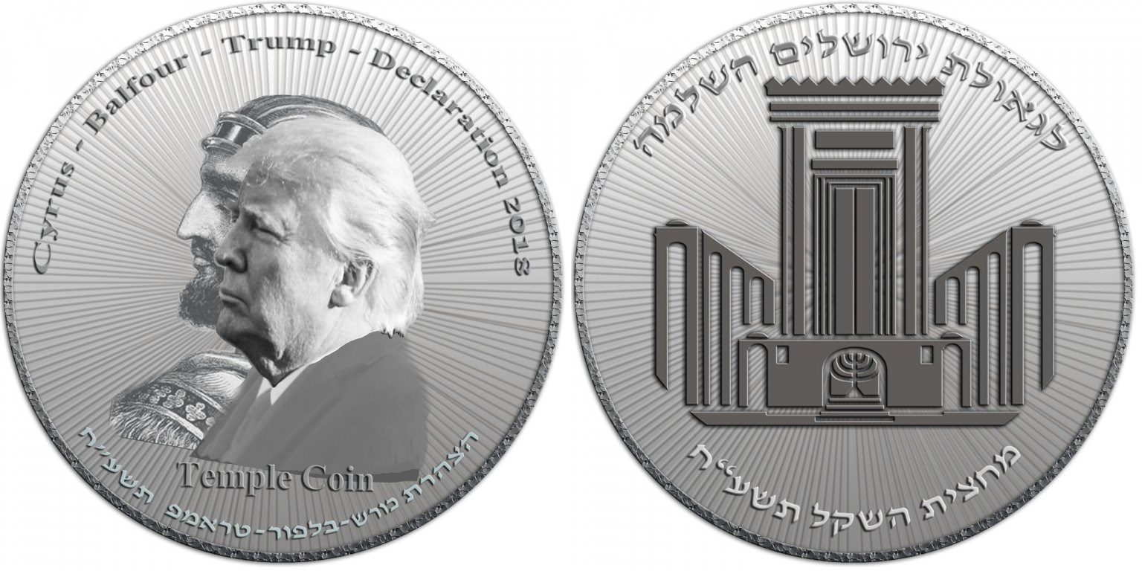
1st series. 1000 minted.

Slide 56
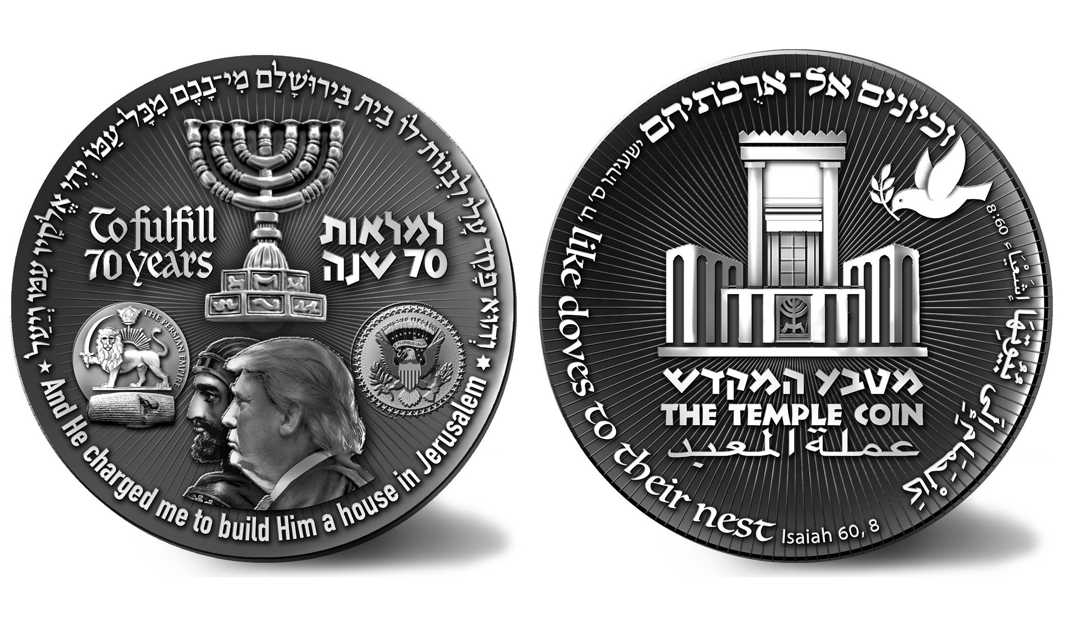
2nd series

Slide 57
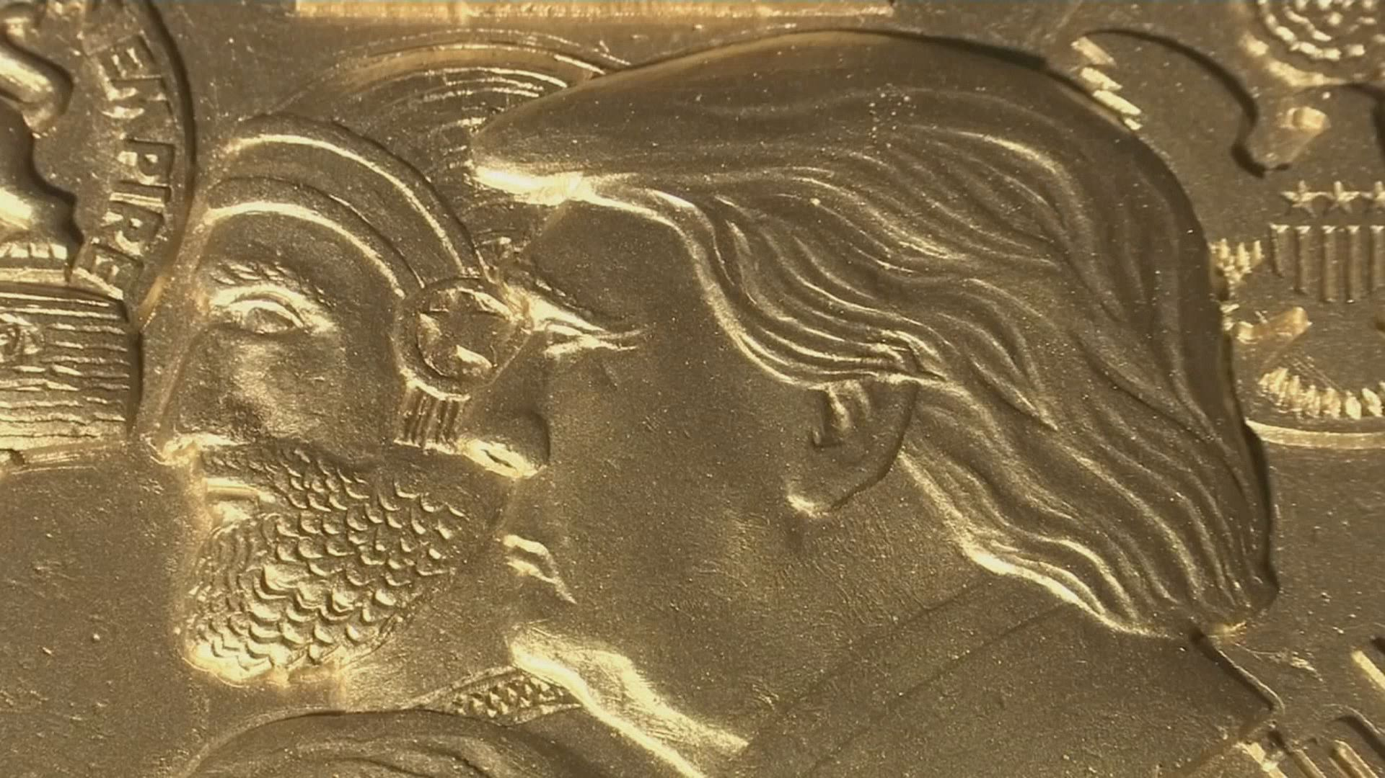

Slide 60
SLIDE TITLE
Subtitle
Books

