Slide 1
My house shall be called a house of prayer for all the nations.
--Mark 11:17 (Isaiah 56:7)

Slide 2
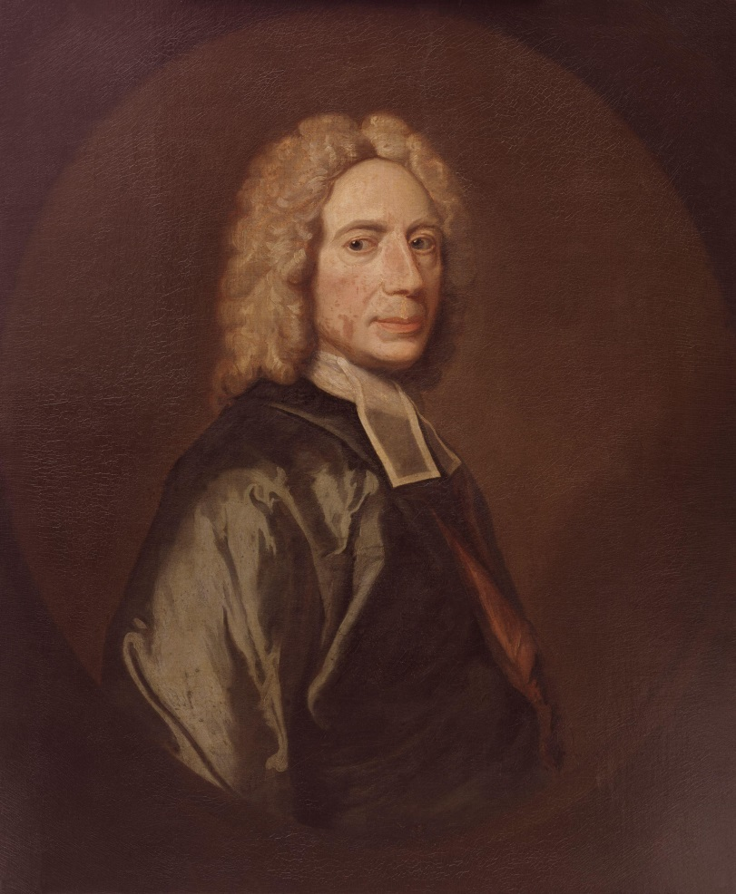
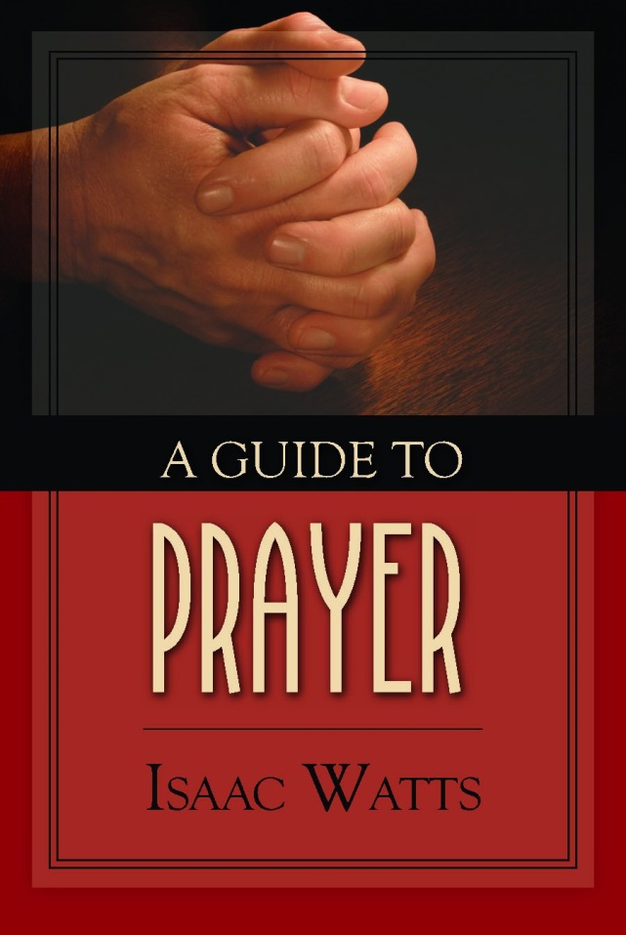

Slide 3
Prayer is required of the churches especially, for the house of God is the house of prayer.

Slide 4
Prayer is the holy skill of conversation with God.

Slide 5
1. The Purpose & Dignity
2. Our Profession to be
Christians
3. The Enjoyment
4. The Honor of God
5. The Ease Of Learning
6. The Consequences of
Neglect

Slide 6
There are children who can only cry after their father and stammer out a broken word or two by which he can understand their meaning.

Slide 7
But these are ungrown infants. The father would rather see his children advancing to manhood and occupying themselves daily with that broad and free conversation with himself which he allows and to which he graciously invites them.

Slide 8
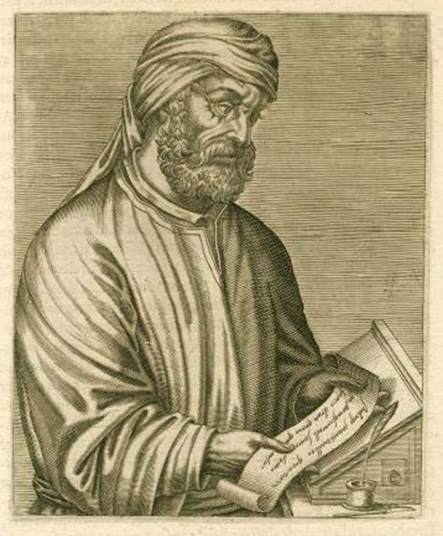
Tertullian 160-220 AD

Slide 9
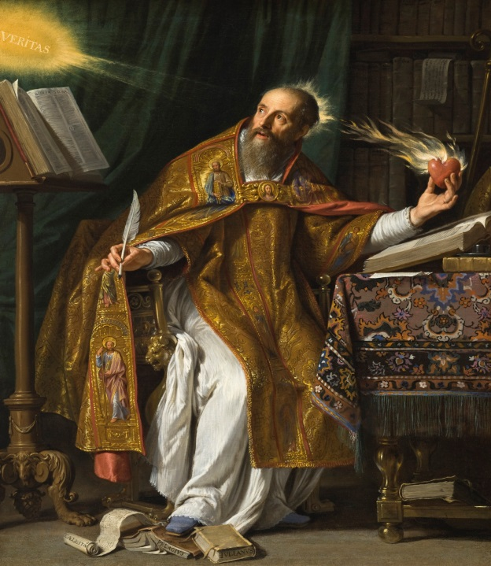
Tertullian 160-220 AD
Augustine 354-430 AD

Slide 10
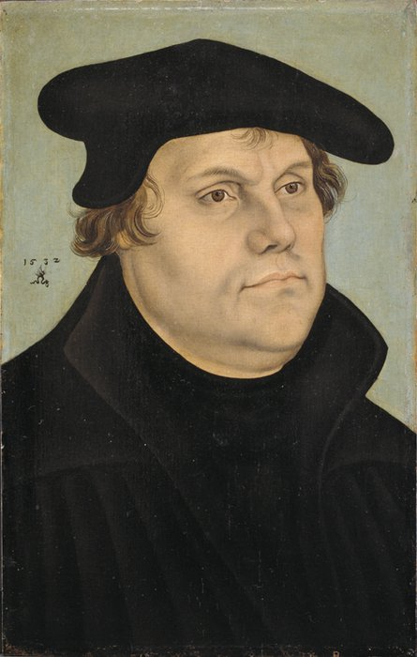
Luther 1483-1546 AD
Tertullian 160-220 AD
Augustine 354-430 AD

Slide 11
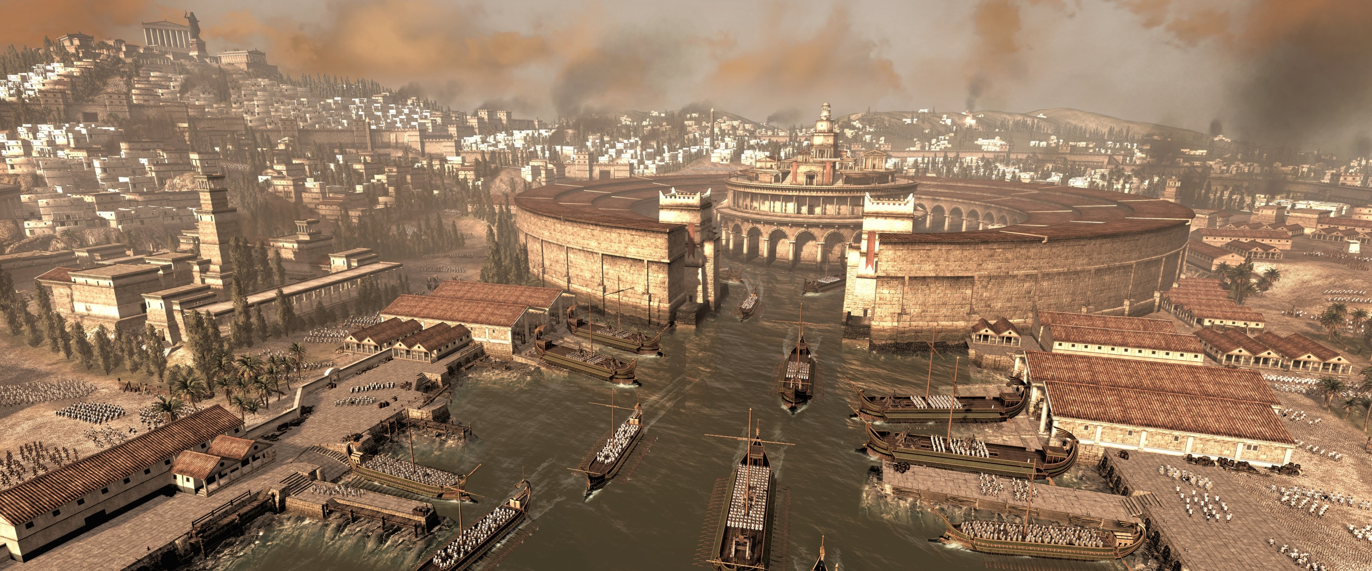
Tertullian (160-220)

Slide 12
Tertullian (160-220)
Defender of the Faith
To heretics, Against Praxeas
To pagans, Apology
The more you mow us down, the more we multiply. The blood of the Christians is seed.

Slide 13
Apology
Having refuted the charges laid against us, let me now show what we really are. We are a body knit together by one faith, one discipline and one hope.

Slide 14
We meet together as a congregation, uniting together to offer prayer to God. We pray for the emperors and all in authority, for the welfare of the world, for peace and for the delay of the final end.

Slide 15
Jesus Christ’s teaching on prayer is new wine stored in
new bottles.

Slide 16
The old prayer, no doubt, brought deliverance from fire and wild beasts and hunger, while yet it had not received its pattern from Christ. Then how much more fully operative is the Christian prayer?

Slide 17
It does not establish the angel of the dew in the midst of the fire, nor block the mouths of lions, nor transfer to the hungry the peasant’s dinner. It turns away by delegated grace no perception of suffering. . .

Slide 18
. . . Yet it arms with endurance those who do suffer and perceive and grieve. It makes grace multiply in power, so that faith may know what it obtains from the Lord, while it understands what, for God’s name, it is suffering.

Slide 19
Moreover, of old time prayer induced plagues, put to flight the hosts of the enemy, withheld the benefits of rain. . .

Slide 20
Now, however, the prayer of righteousness turns aside the whole wrath of God, keeps watch on behalf of foes, makes supplication for persecutors.

Slide 21
It was Christ’s wish for it to work no evil. He has conferred upon it all power concerning good.

Slide 22
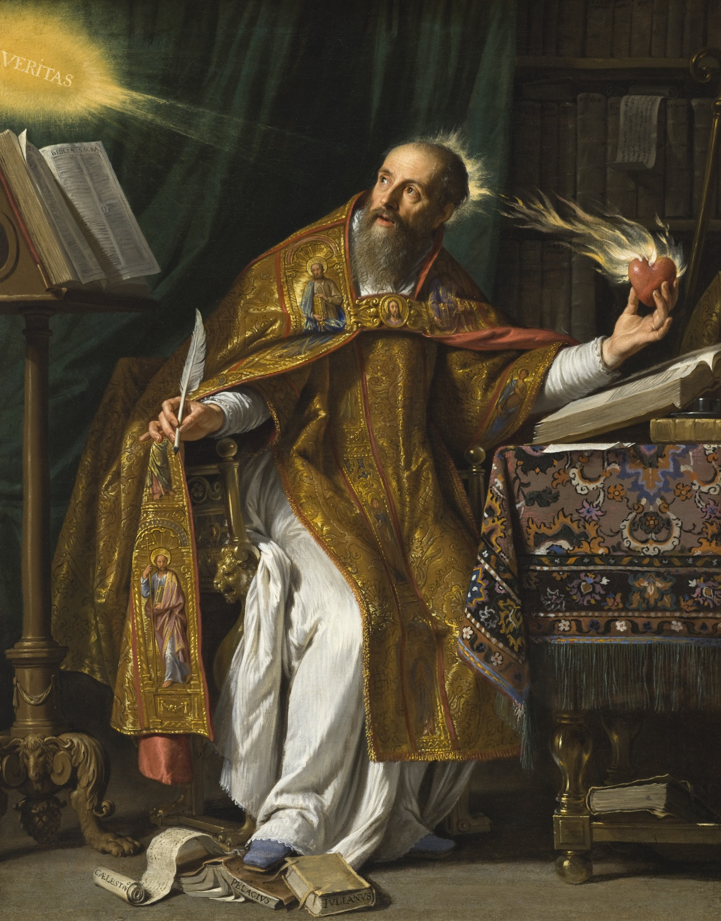
Augustine (354-430)

Slide 23
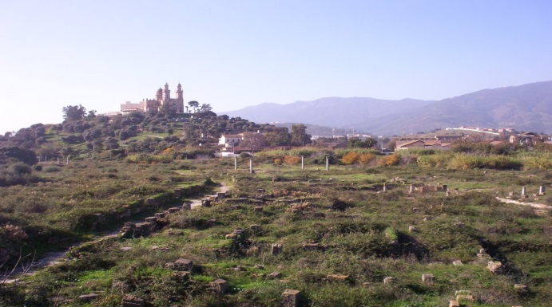
Letter CXXX
(A.D. 412)
What Manner of Person You Should Be
Augustine

Slide 24
Letter CXXX
(A.D. 412)
It becomes you, out of love to this true life to account yourself “desolate “ in this world, however great the prosperity of your lot may be.
Augustine

Slide 25
Augustine
A widow is “desolate” indeed, even though she has sons and grandchildren, and conducts her household piously, entreating all dear to her to put their hope in God: and in the midst of all this, she says in her prayer,

Slide 26
“My soul thirsteth for Thee, my flesh longeth in a dry and thirsty land, where
no water is;” and this dying life is nothing else than such a land, however numerous our mortal comforts, however pleasant our companions in the pilgrimage, and however
Augustine

Slide 27
great the abundance of our
possessions. You know how uncertain all these things are; and even if they were not uncertain, what would they be in comparison with the happiness which is promised in the life to come!
Augustine

Slide 28
In the darkness, then, of this world, in which we are pilgrims absent from the Lord as long as “we walk by faith and not by sight,” the Christian soul ought to feel itself desolate, and continue in prayer.
Augustine

Slide 29
Letter CXXX
(A.D. 412)
What Manner of Person You Should Be
What You Ought To Pray For
You were disturbed by the words, “We know not what we should pray for as we ought.”
Augustine

Slide 30
Letter CXXX
(A.D. 412)
A short solution to your difficulty may be given thus,
Augustine

Slide 31
Letter CXXX
(A.D. 412)
“Pray for a happy life.”
Augustine

Slide 32
1. A happy life if. . . ?
2. A happy life if. . . ?
3. A happy life if. . . ?
4. A happy life if. . . ?

Slide 33
Martin Luther (1483-1546)
Portrait of Martin Luther,
by Lucas Cranach the Elder, 1532

Slide 34
We are as strictly and solemnly commanded to pray as we are to have no other God, to commit no murder and never to steal. Let no one think that it is all the same whether he prays or not, as do the uninstructed people in their delusion who say:

Slide 35
“Why should I pray? Who knows whether or not God will hear and regard my prayer? If I do not pray another will.”
And thus they fall into the habit of never praying.
--Large Catechism, Third Part. point 169

Slide 36
The human heart is by nature so perverse that it always flees from God, thinking that he is averse to our prayers because we are sinners and have merited only his wrath.

Slide 37
By this commandment he makes plain that he will not thrust us aside nor cast us out because we are sinners, but that he would rather draws us to himself and induce us to humble ourselves before him, to confess our misery and need, and pray for mercy and help.

Slide 38
We allow ourselves to be led astray and deterred by thoughts like these: I am not holy enough, not worthy enough. If I were as godly and holy as St. Peter or St. Paul, I would pray.
Away with such thoughts!

Slide 39
The prayer I offer is as precious, as holy and pleasing to God, as that of St. Paul and the holiest of saints. I freely admit that such a one is holier because of his person, but not because of his command. God does not value prayer on account of the person, but on account of his Word and the obedience shown.

