Slide 1
1. The Purpose & Dignity
2. Our Profession to be
Christians
3. The Enjoyment
4. The Honor of God
5. The Ease Of Learning
6. The Consequences of
Neglect

Slide 2
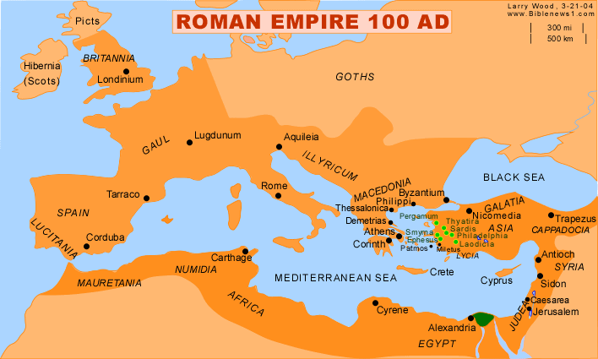

Slide 3
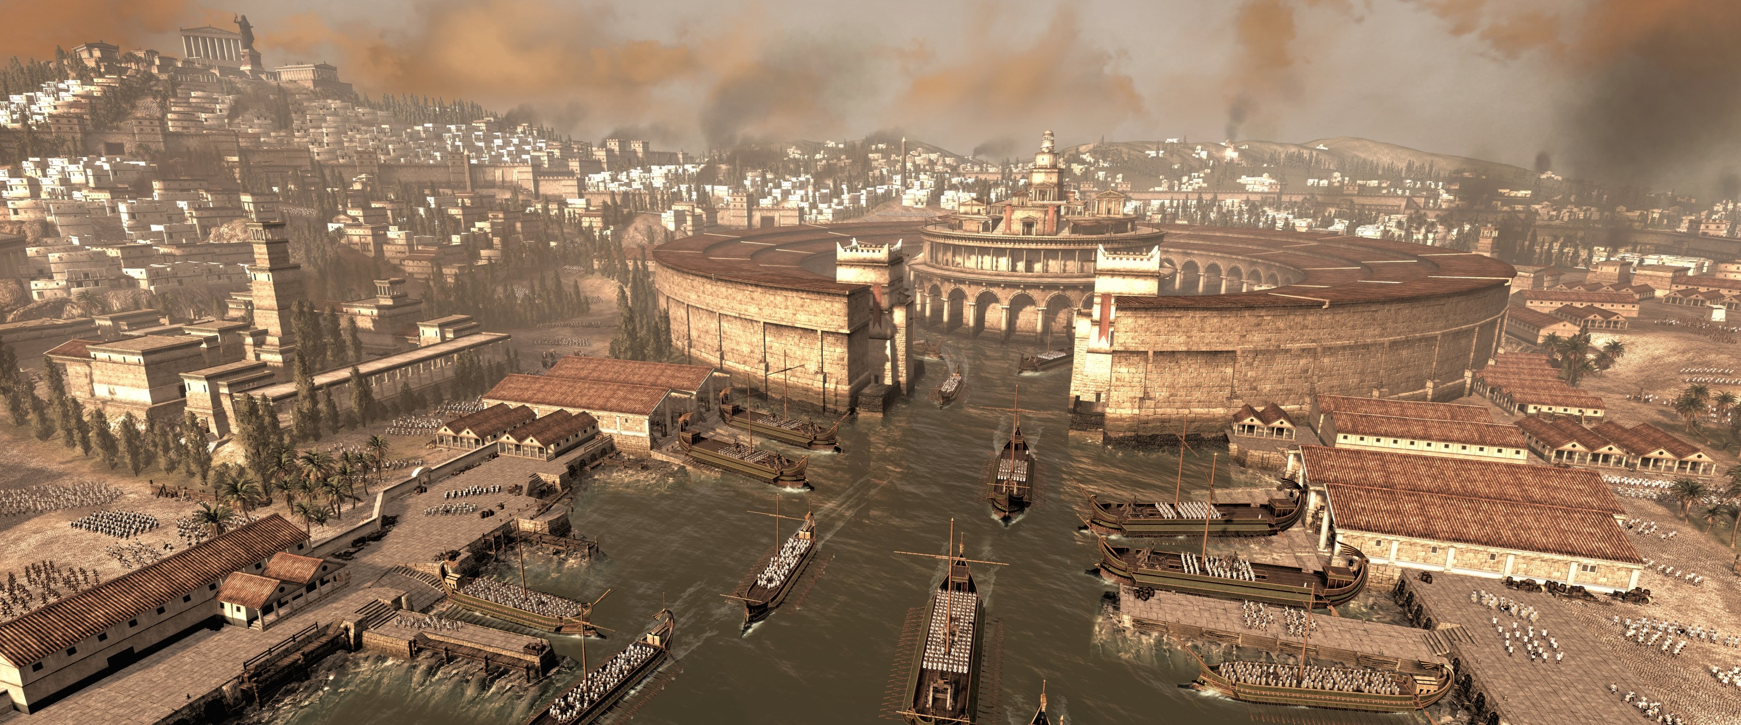

Slide 4
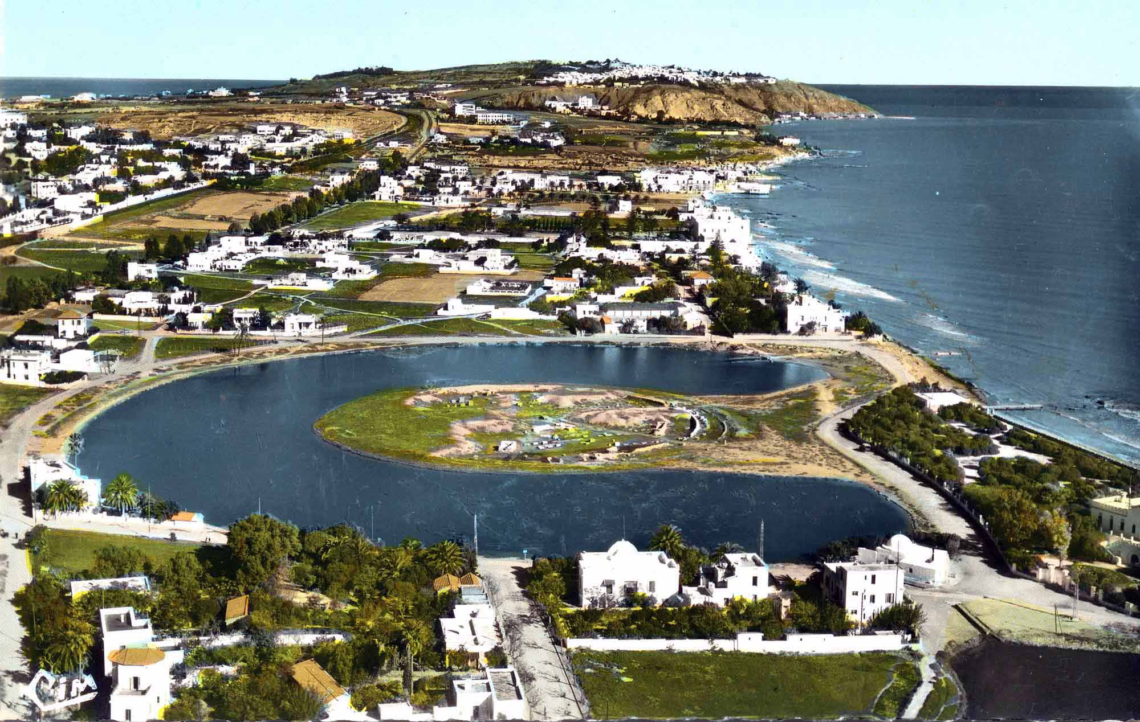

Slide 5
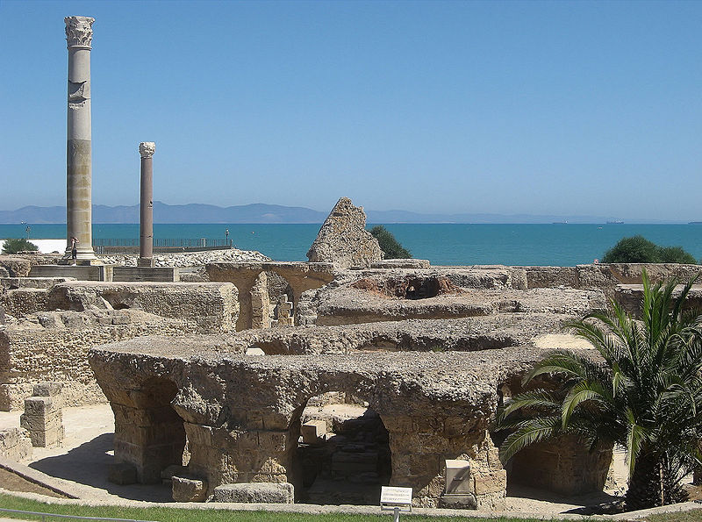

Slide 6
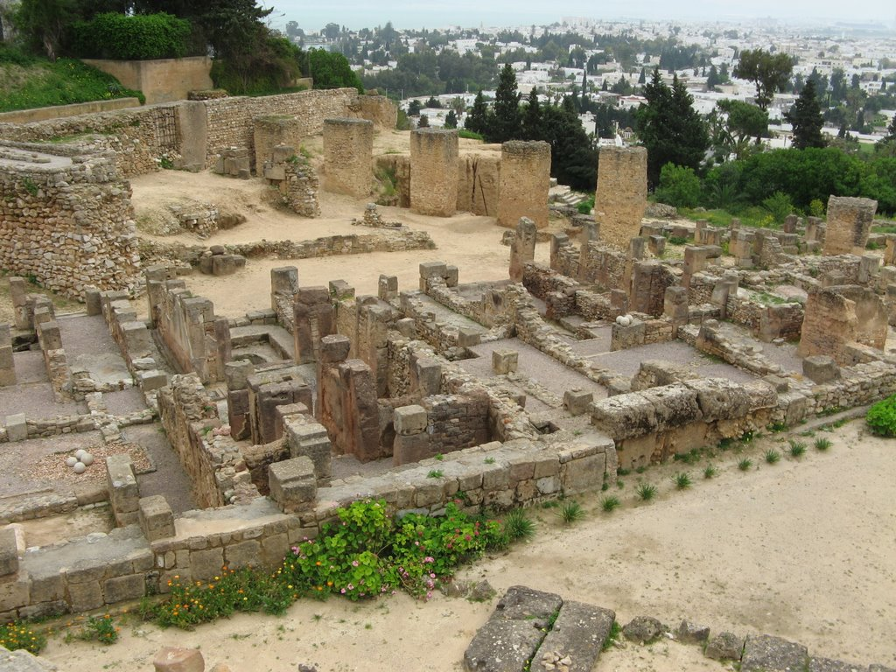

Slide 7
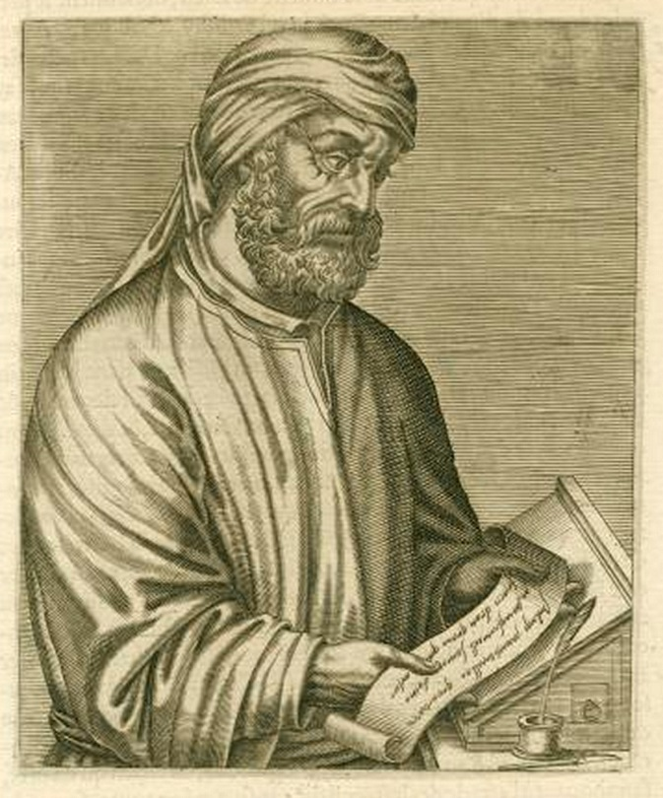

Slide 8
Tertullian (160-220)

Slide 9
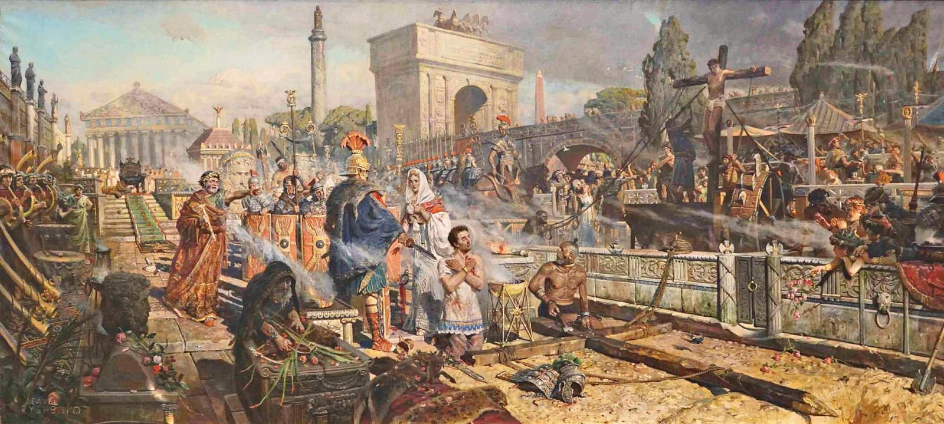

Slide 10
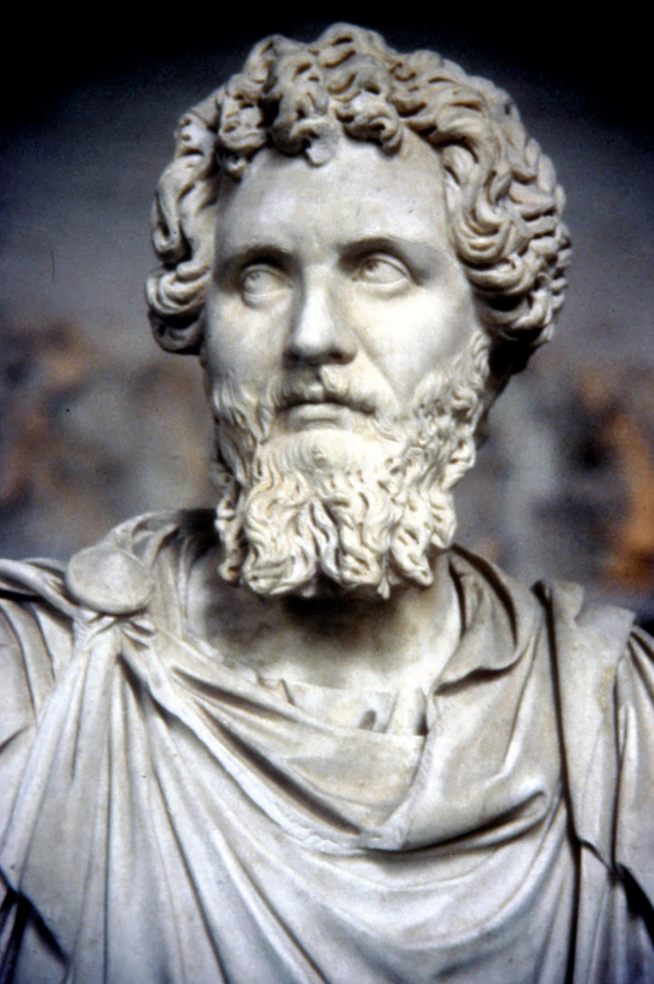
Septimius Severus
(A.D. 202-210)
Alexandria
Rome
Corinth
Carthage
Perpetua (203)

Slide 11
Tertullian (160-220)
Defender of the Faith

Slide 12
Tertullian (160-220)
Defender of the Faith
To heretics, Against Praxeas

Slide 13
Tertullian (160-220)
Defender of the Faith
To heretics, Against Praxeas
To pagans, Apology

Slide 14
Tertullian (160-220)
Defender of the Faith
To heretics, Against Praxeas
To pagans, Apology
The more you mow us down, the more we multiply. The blood of the Christians is seed.

Slide 15
Apology
Having refuted the charges laid against us, let me now show what we really are. We are a body knit together by one faith, one discipline and one hope.

Slide 16
We meet together as a congregation, uniting together to offer prayer to God. We pray for the emperors and all in authority, for the welfare of the world, for peace and for the delay of the final end.

Slide 17
Tertullian (160-220)
Defender of the Faith
To heretics, Against Praxeas
To pagans, the Apology
On Prayer

Slide 18
Tertullian (160-220)
Defender of the Faith
To heretics, Against Praxeas
To pagans, the Apology
On Prayer
The first exposition of the Lord’s Prayer which we have in the history of theology.

Slide 19
Jesus Christ’s teaching on prayer is new wine stored in
new bottles.

Slide 20
Let us take note of his heavenly wisdom.

Slide 21
Let us take note of his heavenly wisdom.
(1) We are to pray in secret.

Slide 22
He made demands upon man’s faith, that he should trust that the sight and hearing of God are present beneath roofs, and extend even into the secret place.

Slide 23
But He also asked for faith’s restraint, that he should offer his devotion to him alone, whom he should believe has ears and eyes in every place.

Slide 24
Let us take note of his heavenly wisdom.
(1) We are to pray in secret.
(2) We do not need to draw near to our Lord with an army of words.

Slide 25
Let us take note of his heavenly wisdom.
(1) We are to pray in secret.
(2) We do not need to draw near to our Lord with an army of words.
(3) That brevity rests upon the foundation of a great and fruitful interpretation.

Slide 26
It begins with a work of faith, when we say, “Our Father, who art in Heaven.”

Slide 27
It begins with a work of faith, when we say, “Our Father, who art in Heaven.”
(1) We are sons of God.

Slide 28
It begins with a work of faith, when we say, “Our Father, who art in Heaven.”
We are sons of God.
John 1:12

Slide 29
It begins with a work of faith, when we say, “Our Father, who art in Heaven.”
We are sons of God.
John 1:12
Isaiah 1:2

Slide 30
It begins with a work of faith, when we say, “Our Father, who art in Heaven.”
We are sons of God.
We are giving God a name of both affection and authority.

Slide 31
It begins with a work of faith, when we say, “Our Father, who art in Heaven.”
We are sons of God.
We are giving God a name of both affection and authority.
We are calling upon the Son.

Slide 32
Hallowed be thy name

Slide 33
Hallowed be thy name
John 5:43
John 12:28
John 17:6

Slide 34
Hallowed be thy name
Isaiah 6:3
Revelation 4:8

Slide 35
Hallowed be thy name
We are learning that heavenly address to God and that service of the glory that is to be.

Slide 36
Hallowed be thy name
Our petition is for it to be hallowed in us who are in Him.

Slide 37
Thy will be done in heaven and in earth
That in us the will of God may be done in earth, so that it may be possible, of course, for it also to be done in heaven.

Slide 38
We ask then for him to supply us with the sum and substance of his will, that we may be saved, both in heaven and in earth: because the sum total of his will is the salvation of those he has made his children.

Slide 39
Also, in saying, “Thy will be done,” we wish well for ourselves on this ground also, that there is no evil in God’s will. . .

Slide 40
In fact, by saying this we forewarn ourselves with a view to endurance.

Slide 41
Thy kingdom come

Slide 42
Thy kingdom come
Our desire is to reign the sooner and to be no longer slaves.

Slide 43
Give us today our daily bread
Mathew 6:34
Luke 12:20

Slide 44
How many edicts of prophets, gospels, and apostles, how many discourses, parables, examples and precepts of the Lord are touched upon in the brevities of a few short words. How many duties are summed up all at once.

Slide 45
In “Father,” the honor of God, in “name,” our witness to the faith, in “will,” the sacrifice of obedience, in “kingdom,” the commemoration of our hope. . .

Slide 46
. . . in “bread” the petition for life, in the prayer for pardon the confession of debts, in the request for safeguard wariness against temptations.

Slide 47
God alone was competent to teach us how he wished to be prayed to. Yet, since the Lord, the foreseer of human necessities, says in a different context, “Ask and ye shall receive,” and as there are things to be

Slide 48
asked for according to each
man’s circumstances, we have the right, after rehearsing the prescribed and regular prayer as a foundation, to make from other sources a superstructure of petitions for additional desires,

Slide 49
yet with mindfulness of the precepts, lest we be as far from the ears of God as we are from the precepts.

Slide 50
The old prayer, no doubt, brought deliverance from fire and wild beasts and hunger, while yet it had not received its pattern from Christ. Then how much more fully operative is the Christian prayer?

Slide 51
It does not establish the angel of the dew in the midst of the fire, nor block the mouths of lions, nor transfer to the hungry the peasant’s dinner. It turns away by delegated grace no perception of suffering. . .

Slide 52
. . . Yet it arms with endurance those who do suffer and perceive and grieve. It makes grace multiply in power, so that faith may know what it obtains from the Lord, while it understands what, for God’s name, it is suffering.

Slide 53
Moreover, of old time prayer induced plagues, put to flight the hosts of the enemy, withheld the benefits of rain. . .

Slide 54
Now, however, the prayer of righteousness turns aside the whole wrath of God, keeps watch on behalf of foes, makes supplication for persecutors.

Slide 55
It was Christ’s wish for it to work no evil. He has conferred upon it all power concerning good.

Slide 56
Beneath the armor of prayer let us guard our Emperor’s standard. Let us pray while waiting for the angel’s trumpet. Even the angels pray, all of them. . . Even the Lord himself prayed. To him be honor and power forever and ever.

